Slide 1


Slide 2
Native STAND 2.0
Handouts and Visual Aids to Project on a Screen for the Class

Slide 3
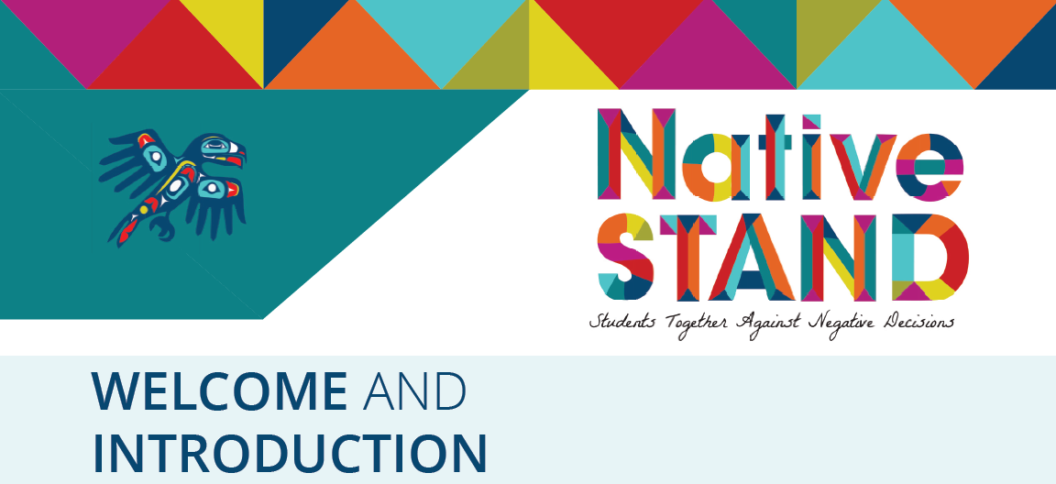

Slide 4
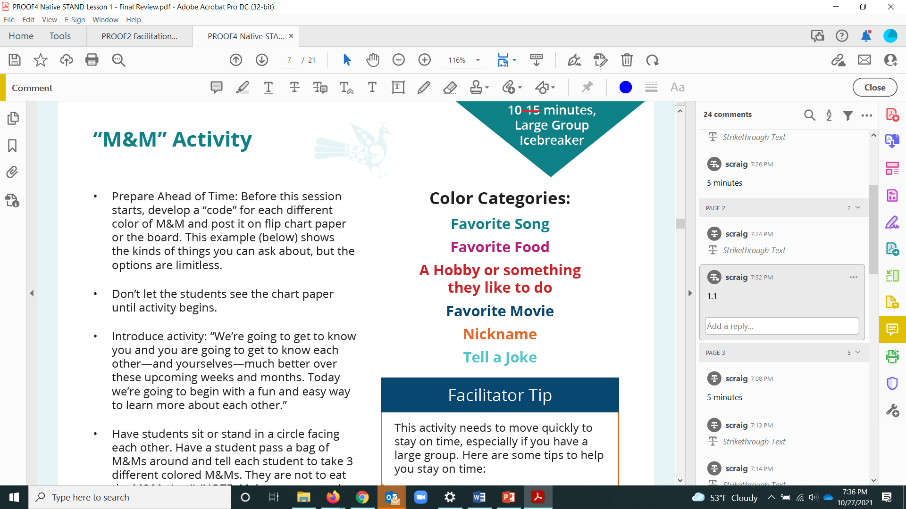

Slide 5
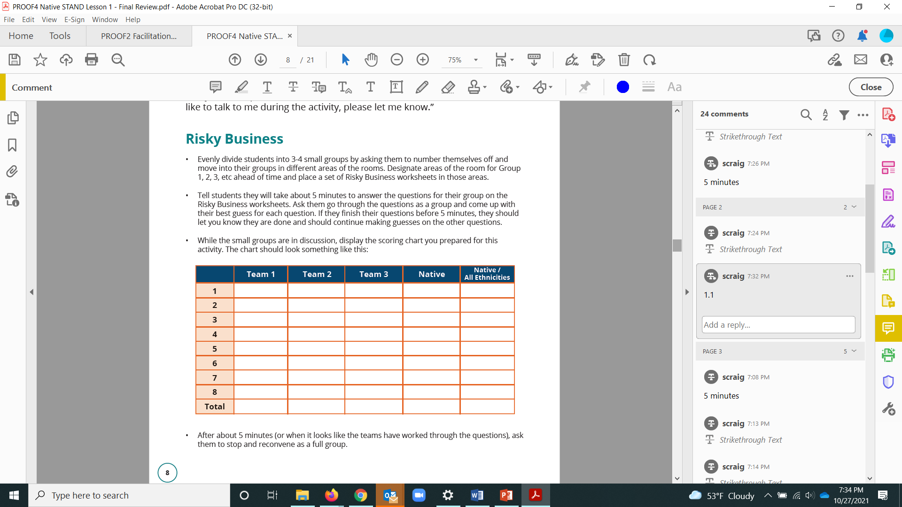

Slide 6
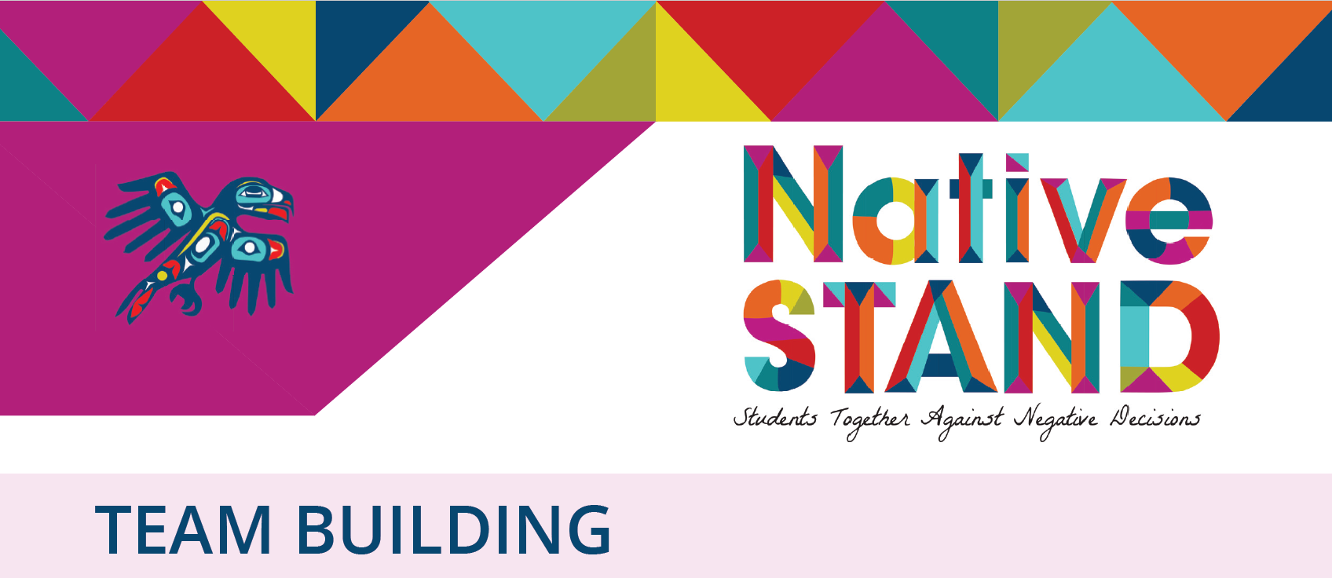
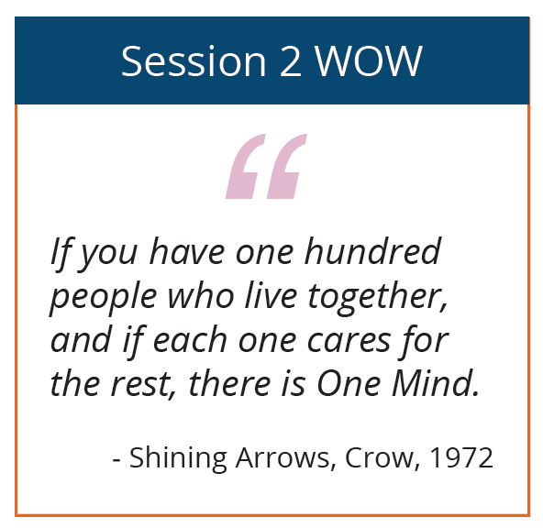
Notes:
Lesson 2

Slide 7
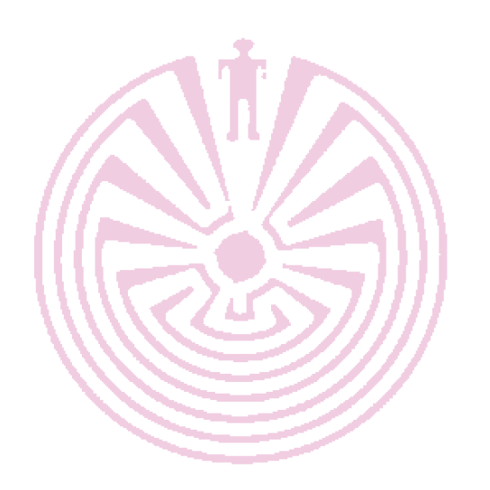
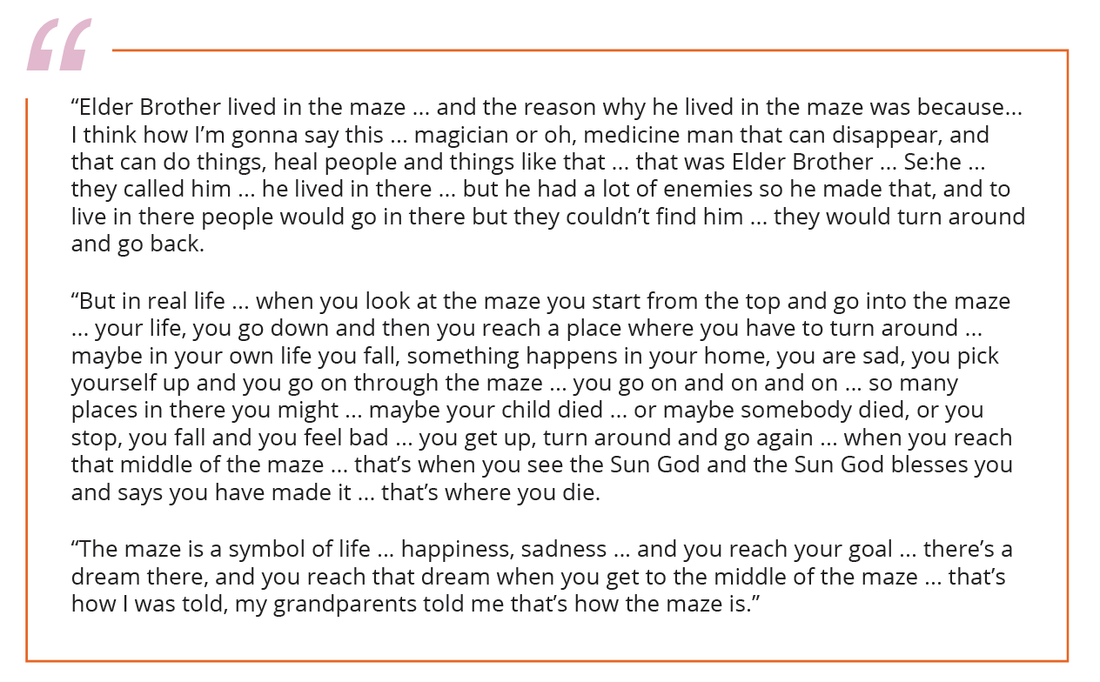
Notes:
Lesson 2

Slide 8
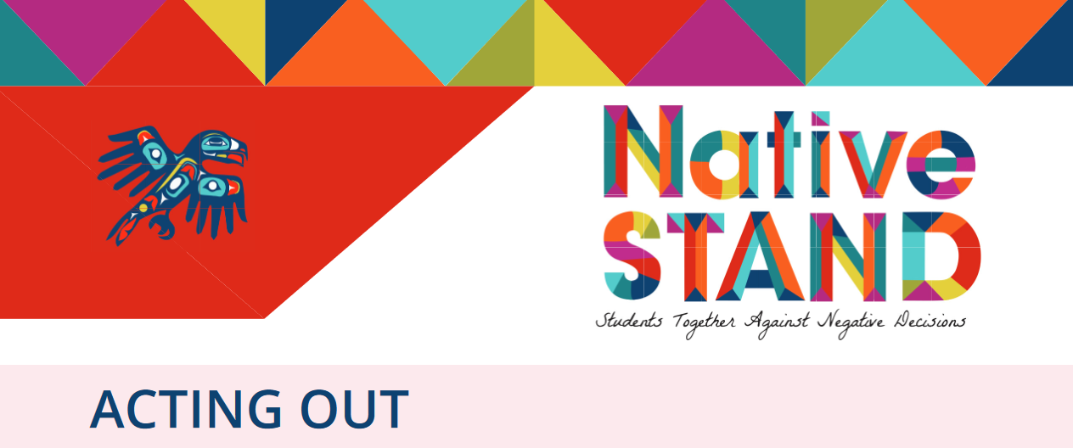
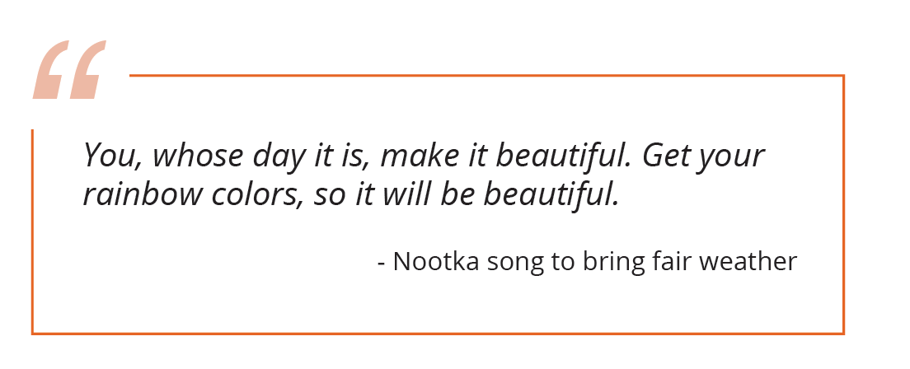
Notes:
Lesson 3

Slide 9
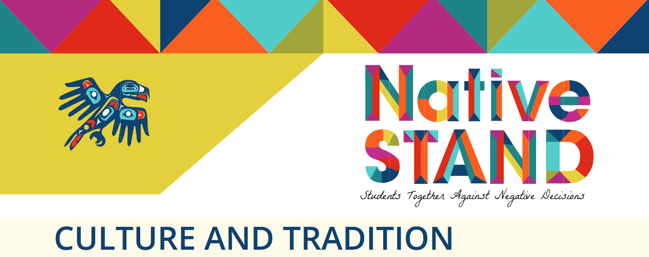
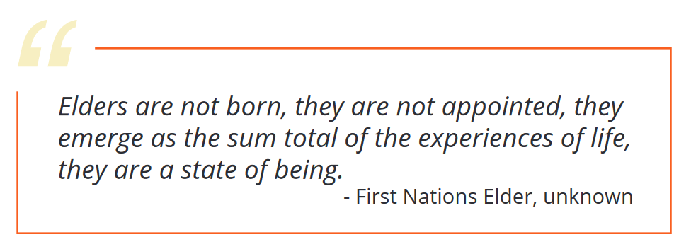
Notes:
Lesson 4

Slide 10
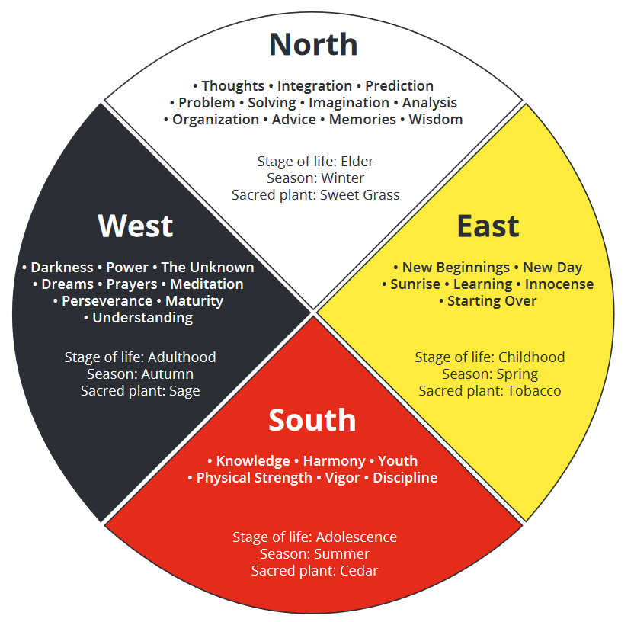

Slide 11
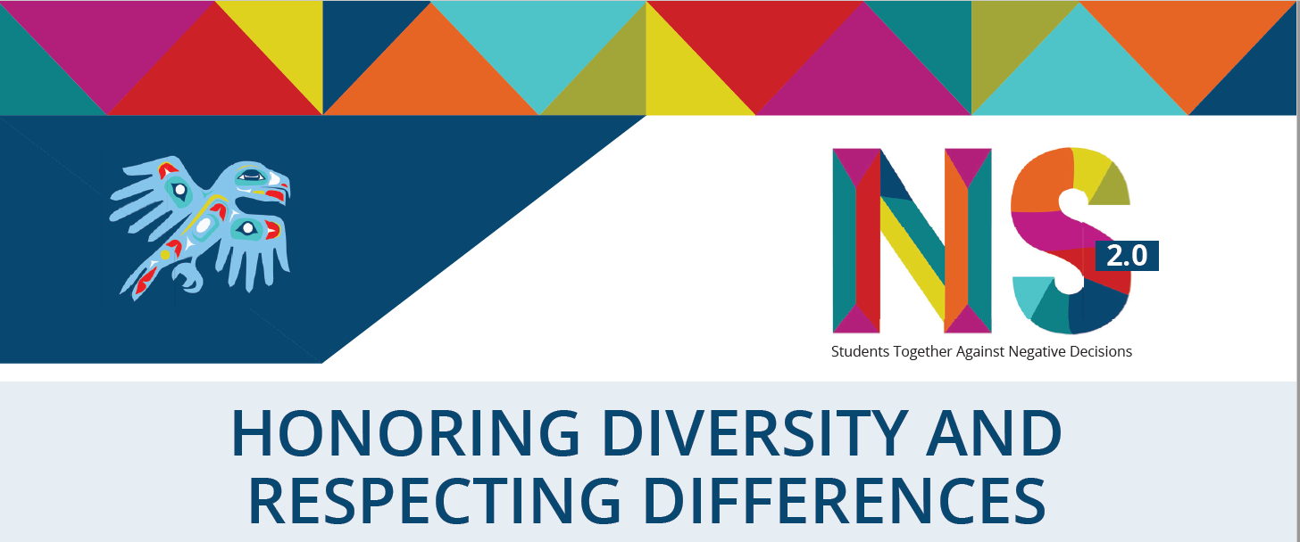
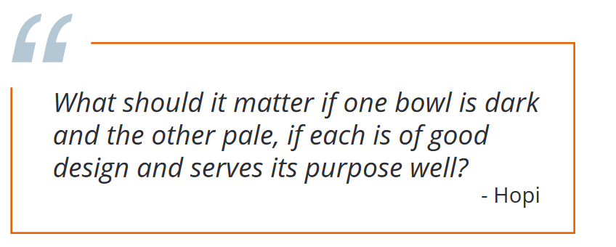
Notes:
Lesson 5

Slide 12
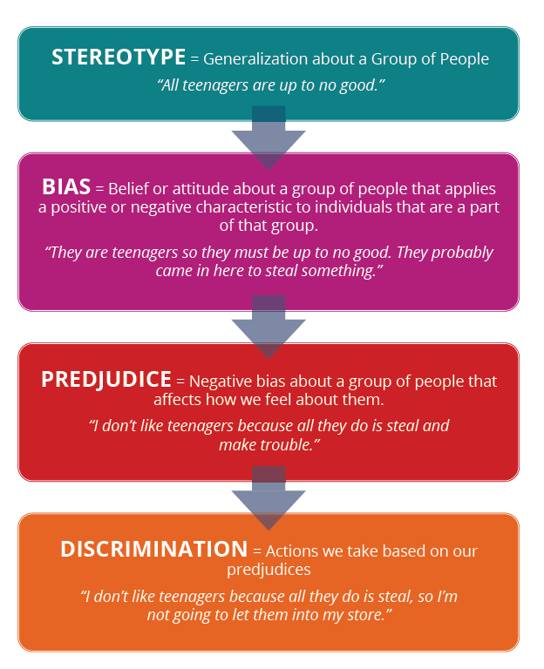

Slide 13
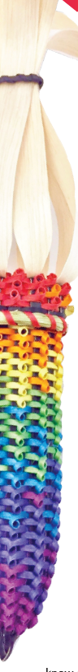
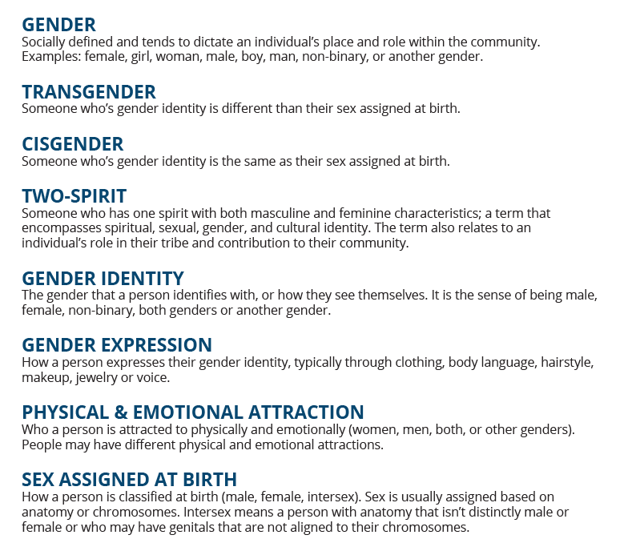

Slide 14
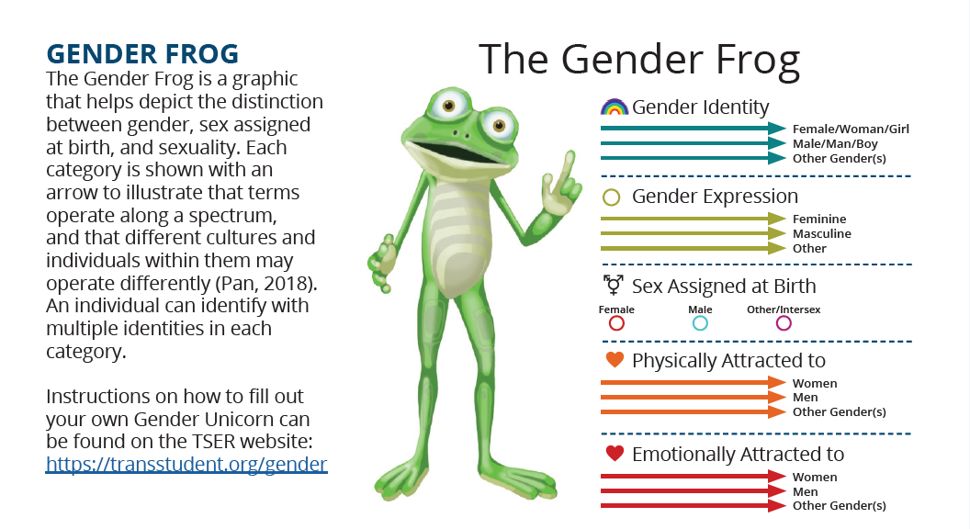
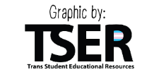

Slide 15
Pronoun Activity
This is [insert name], [insert pronoun] uses [insert pronoun] pronouns.
[Name or pronoun] enjoys [insert activity] and is interested in [insert interest].
Notes:
All people deserve our respect – we can show respect by using the pronouns and identities people request and adjusting them if they change over time.

Slide 16
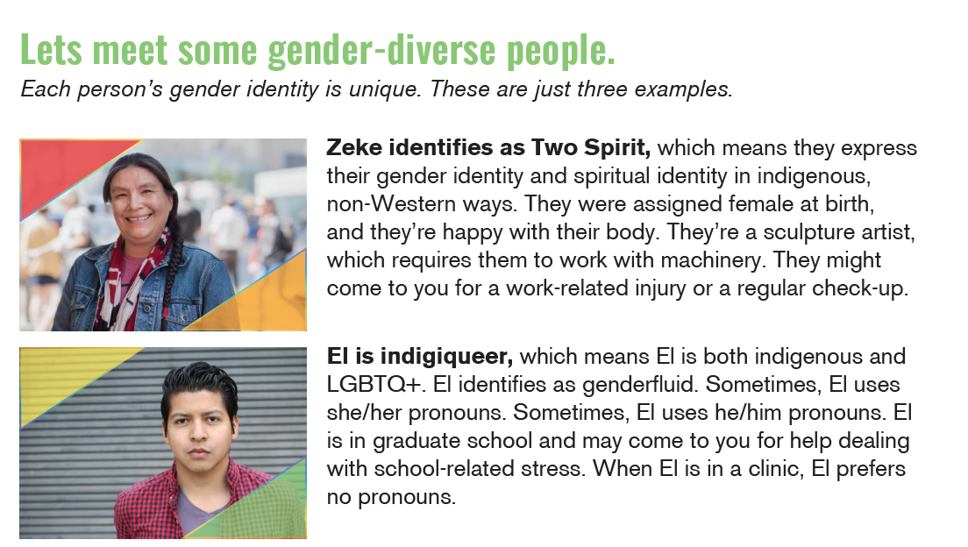
Notes:
For more resources, text
2SLGBTQ to 94449 or visit
https://www.pathsremembered.org/

Slide 17
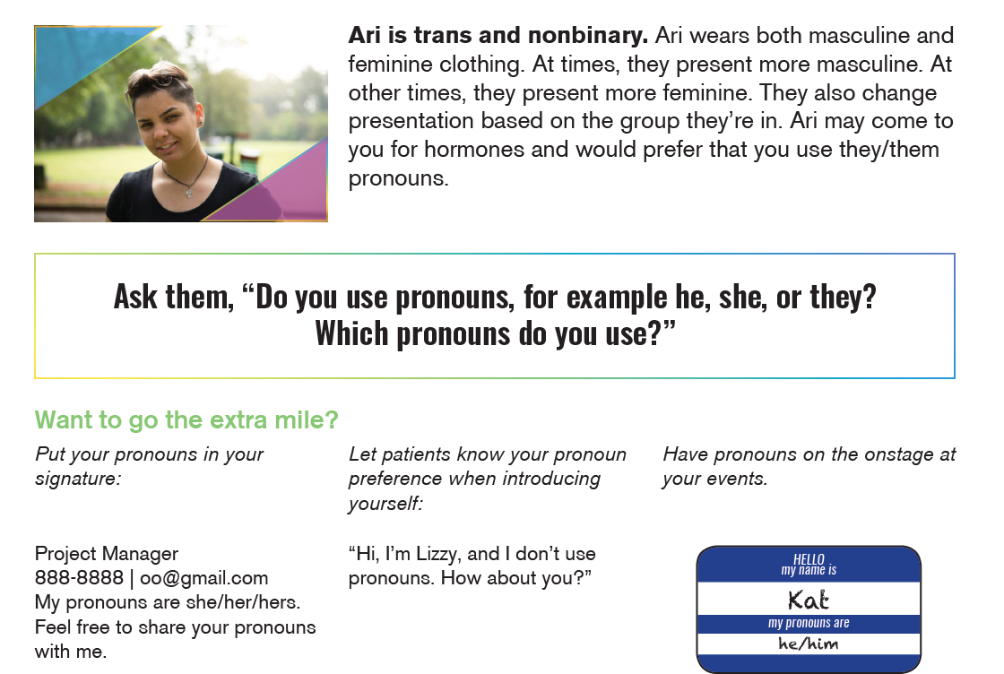
Notes:
For more resources, text
2SLGBTQ to 94449 or visit
https://www.pathsremembered.org/

Slide 18
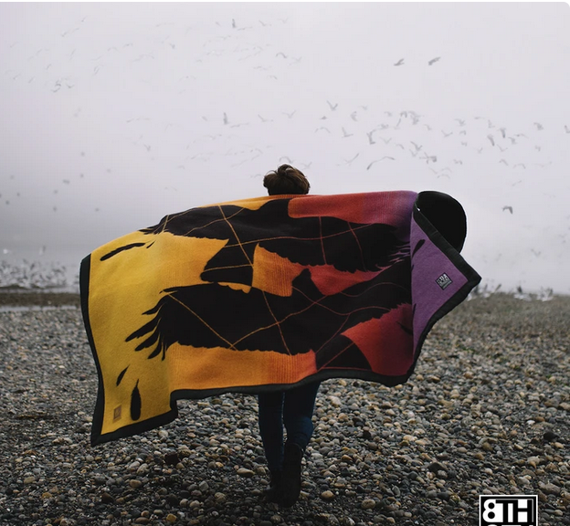
“The story goes that the crow was once very colorful and had a beautiful singing voice, but during a forest fi re, it spent so much time trying to help the other animals that its colorful feathers became blackened with soot and its beautiful singing voice turned hoarse from the smoke… this story reflects the struggles and sacrifices made by Two-Spirit people to get to where they are today. The blanket mirrors the story, as one side features two brightly colored crows while the other side the two crows are all black.”
https://eighthgeneration.com/products/two-spirit-wool-blanket
Notes:
Two Spirit artist Ryan Young (Lac du Flambeau Band of Lake Superior Chippewa) created this blanket to celebrate the sacrifices of 2SLGBT+ people. The crow comes from the story below:

Slide 19
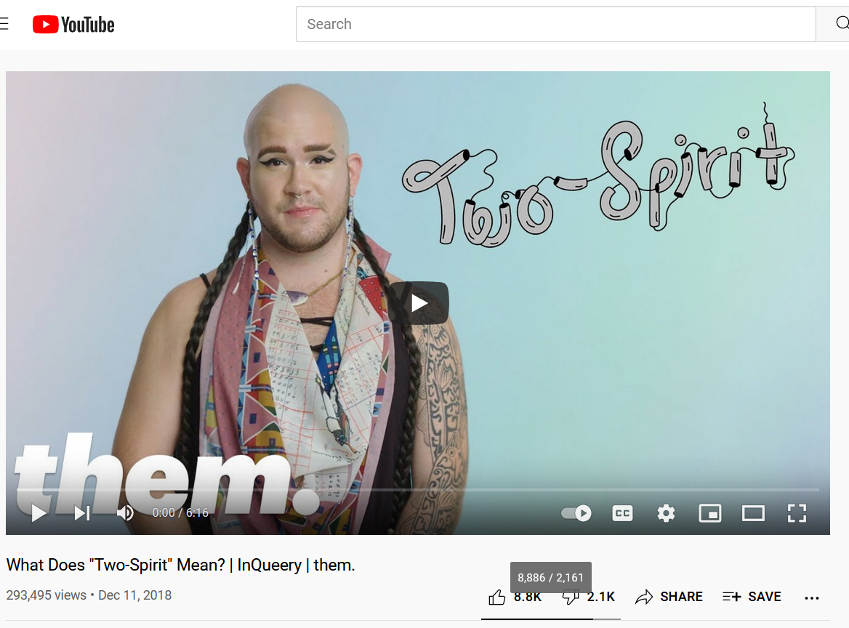
https://youtu.be/A4lBibGzUnE

Slide 20
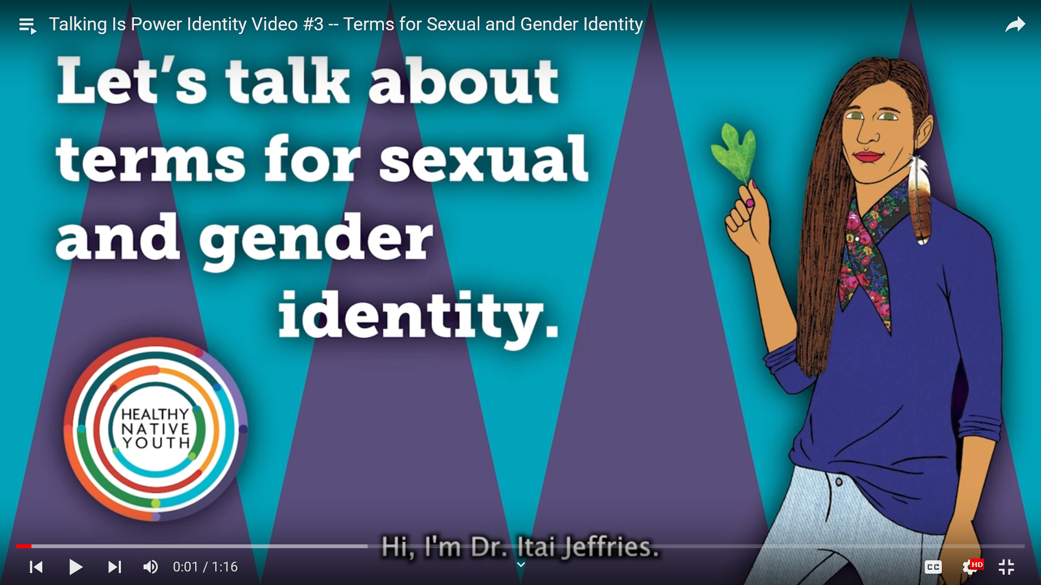
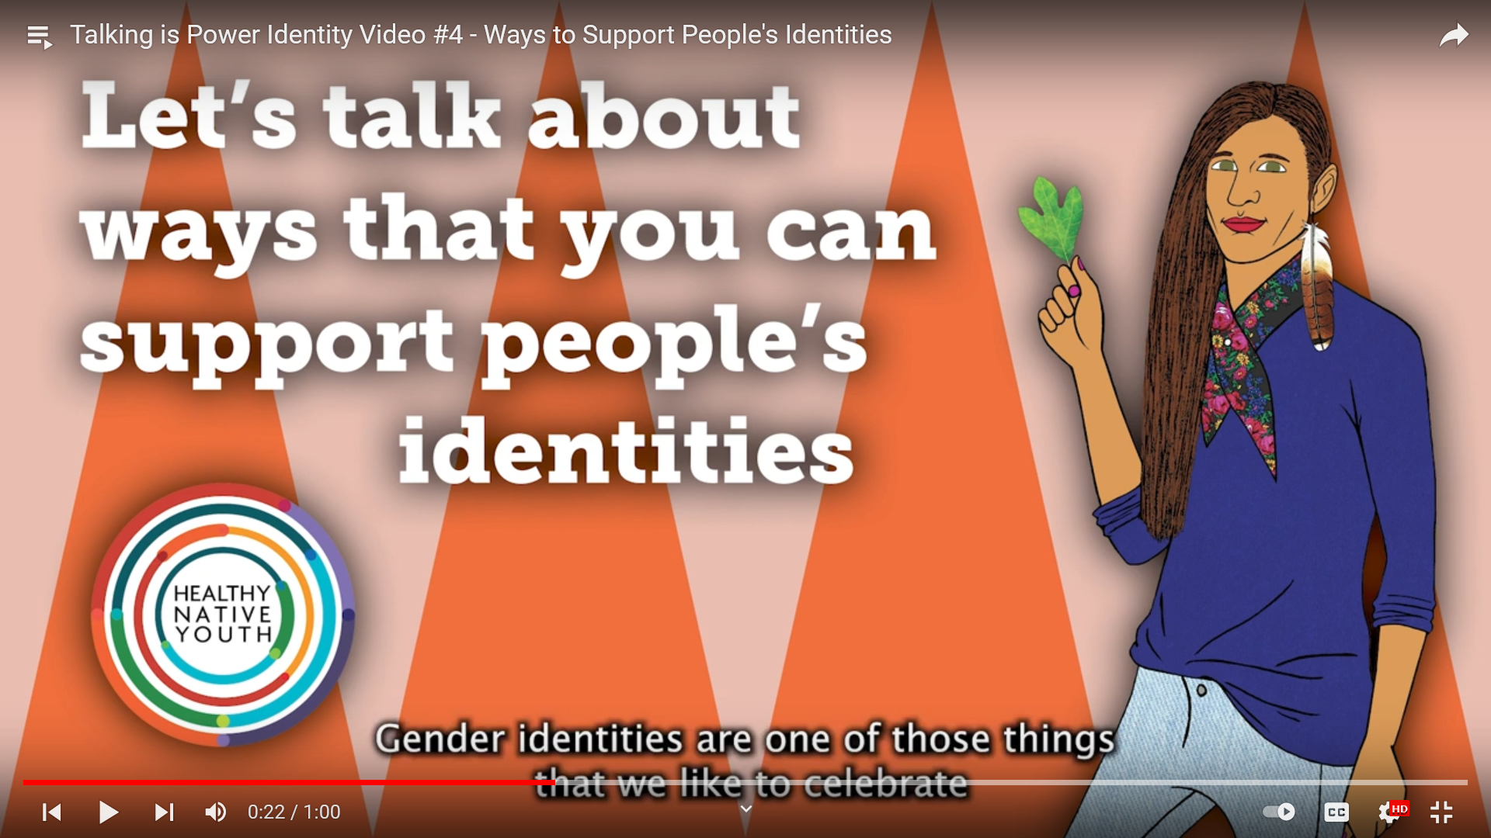
Video 1: Identity – Dr. Itai Jeffries (Occaneechi) of the Northwest Portland Area Indian Health Board’s Paths Remembered Two Spirit Project, digs into sexual and gender identity.
Video 2: Internal & External Identity - Dr. Jeffries talks about the important role that our internal and external identities play into how we are perceived and what happens when those identities don’t match.
Video 3: Terms for Sexual and Gender Identity - Dr. Jeffries shares terminology used for sexual and gender identity.
Video 4: Ways to Support People’s Identities - Dr. Jeffries discusses ways to support people’s identities, including their sexual and gender identity.
HNY Playlist: youtube.com/playlist?list=PLiKVo_vO0vou-hsRiwPdCvzx_nrej4OHu

Slide 21
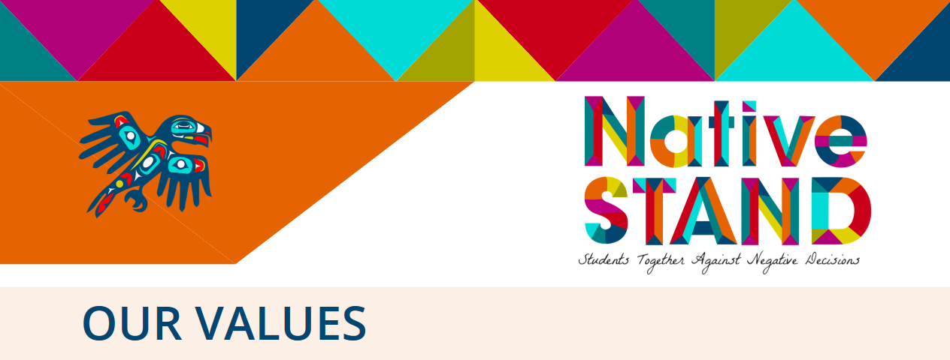
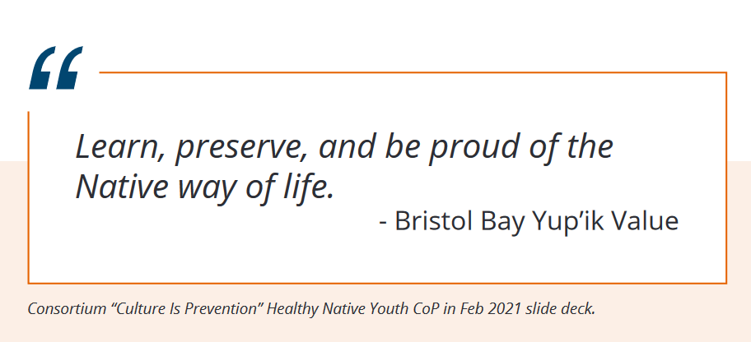
Notes:
Lesson 6

Slide 22
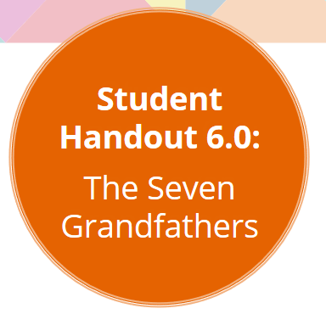
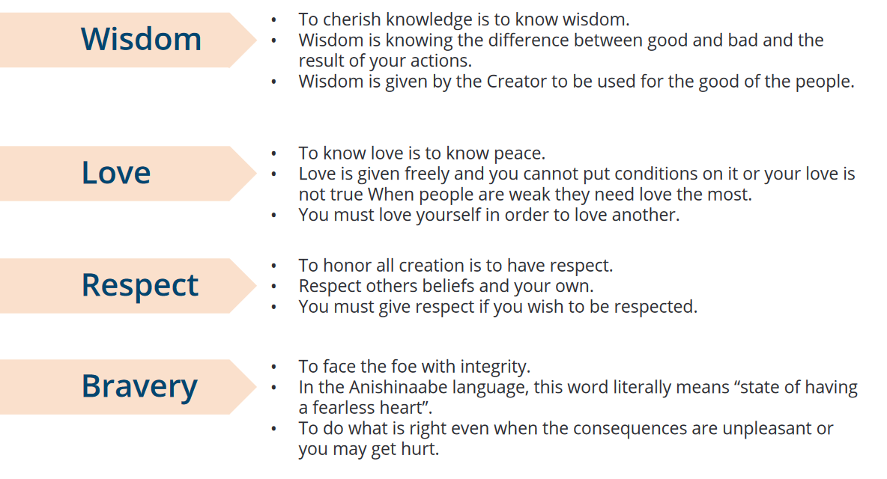

Slide 23
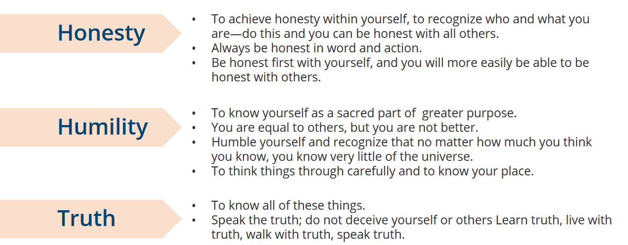

Slide 24
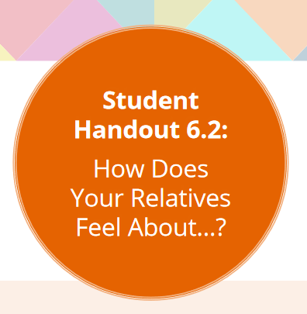
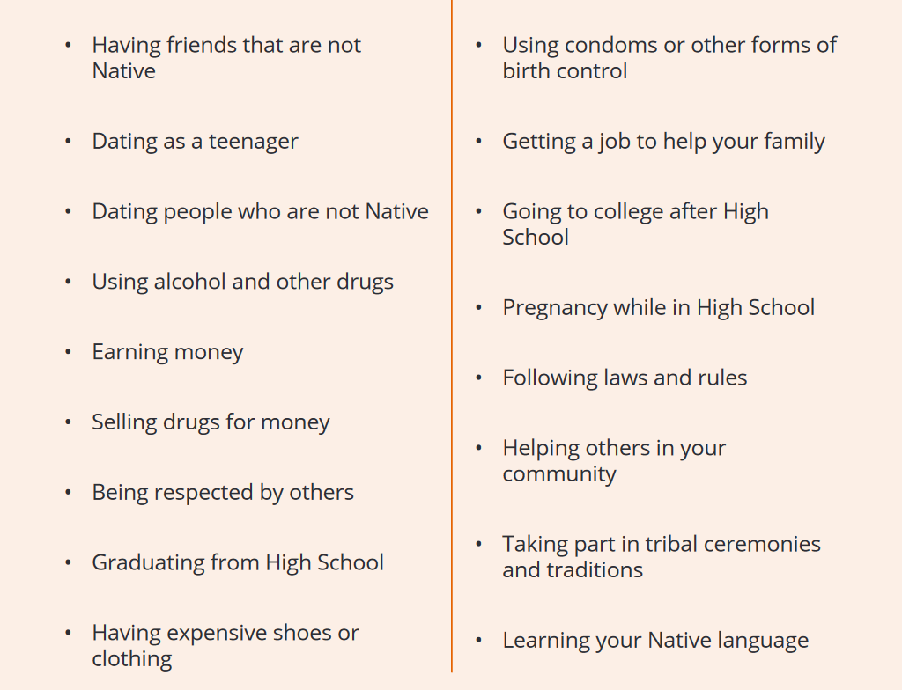

Slide 25
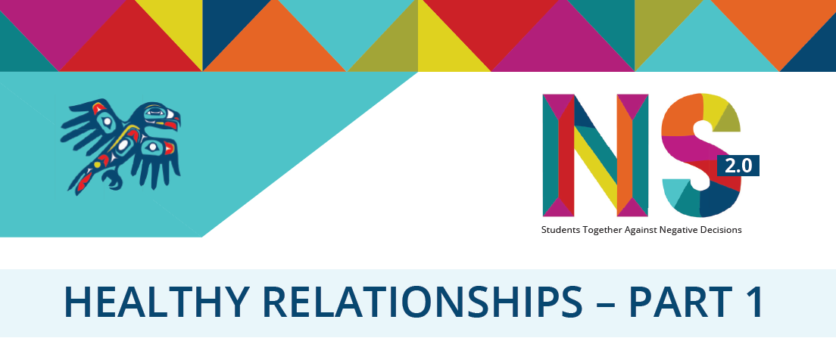
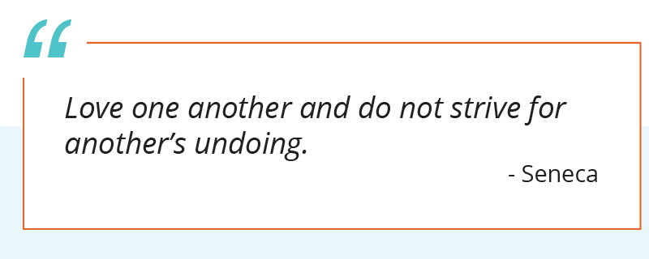

Slide 26
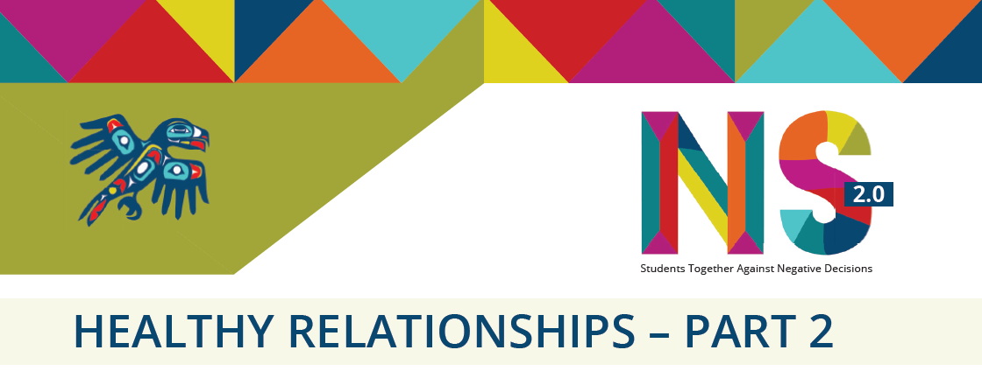
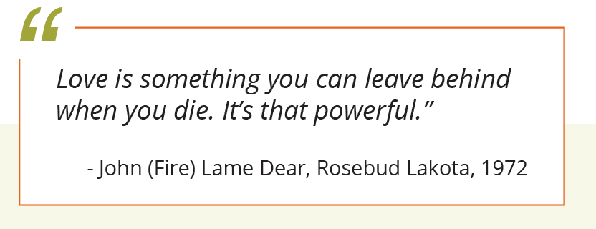

Slide 27
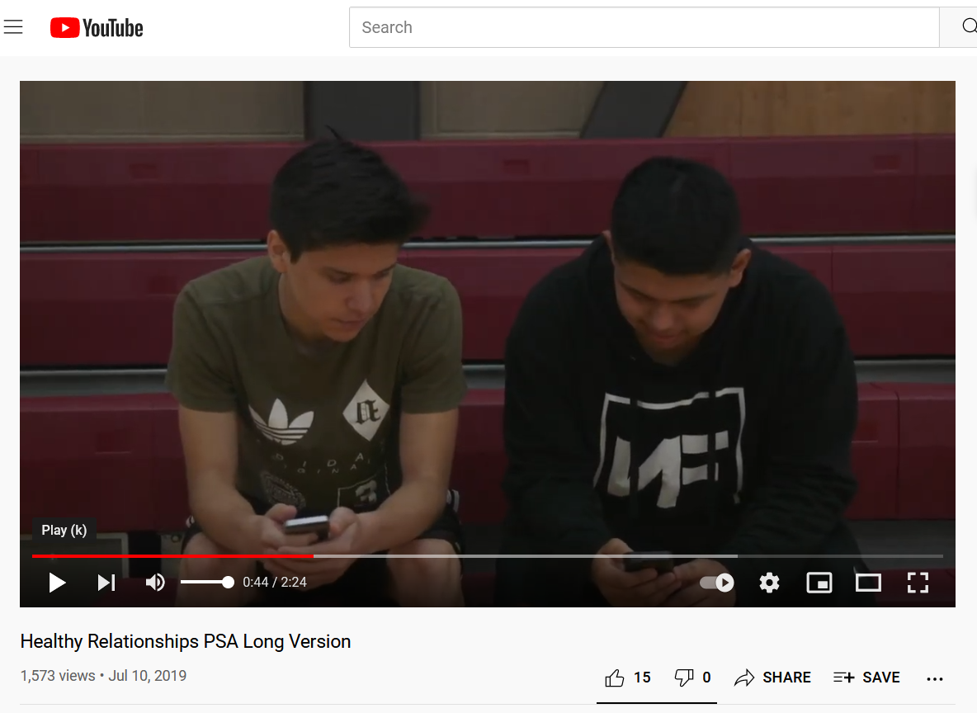
https://youtu.be/5jy-jVMi2zY

Slide 28
Role Play Scenarios
A friend is in a new relationship and you don’t know their partner. What would you say and do to check in about how their relationship is going?
Your friend has been dating their partner for several weeks and you notice they are spending less time with your friend group. They are getting in arguments and getting a lot of text messages even when they are with their friends. What would you say or do to provide support for your friend?
You notice your friend’s partner always seems sad after being with them. Your friend tells their partner what to do, how to dress and calls them unkind names. What would you say and do to support your friend in getting help? Who would you reach out to?

Slide 29
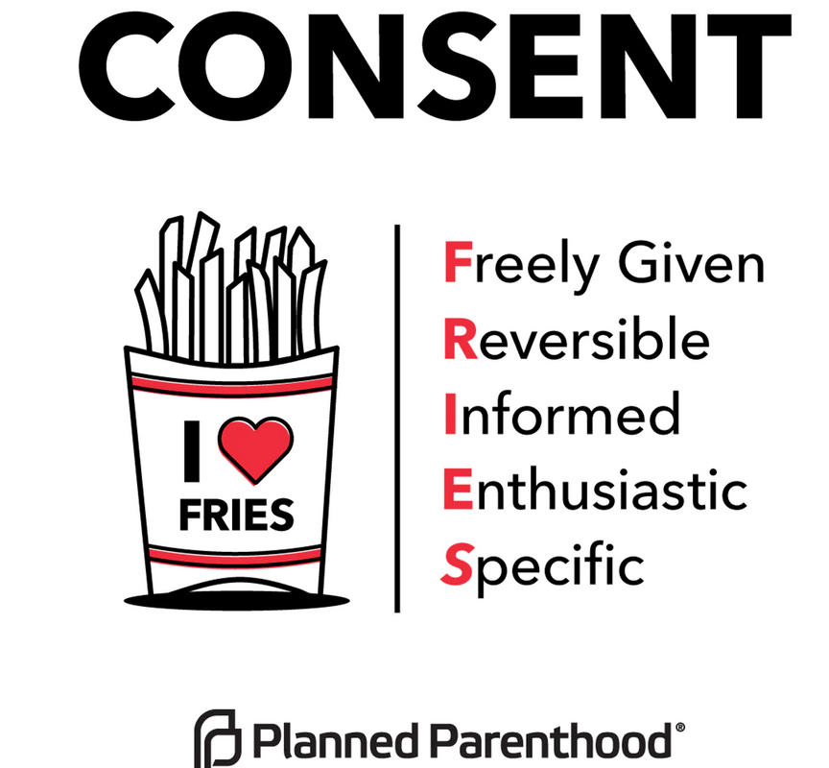

Slide 30
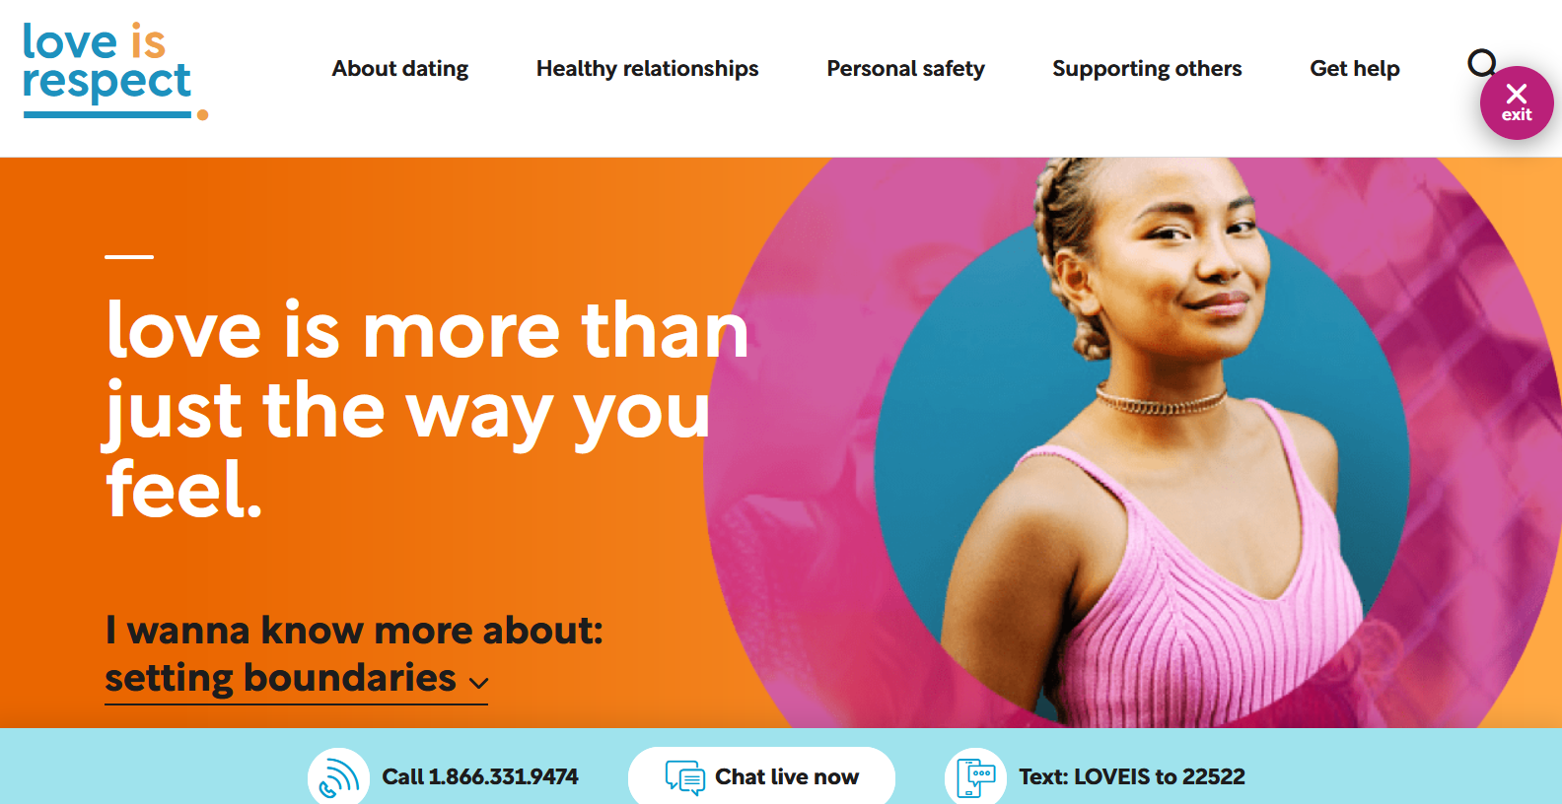

Slide 31
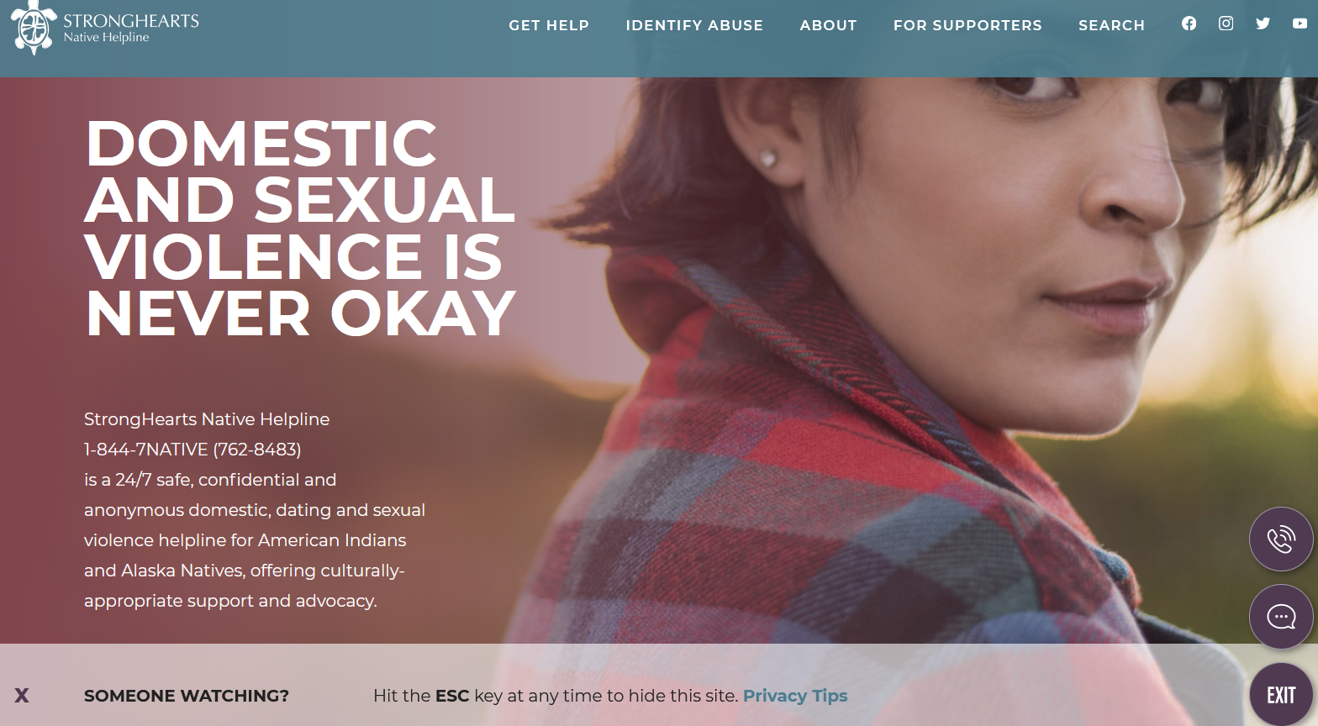

Slide 32
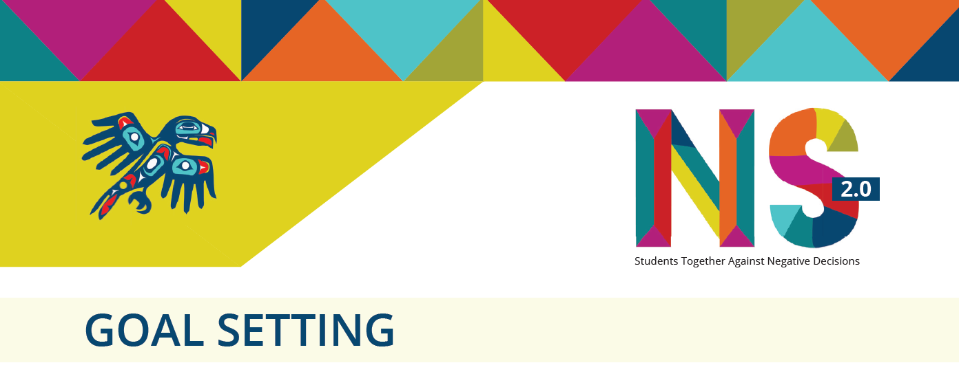
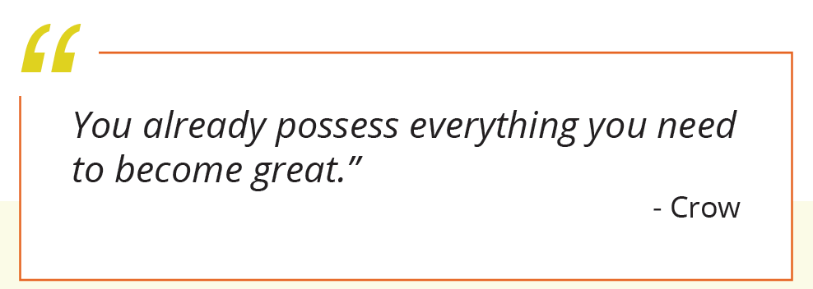

Slide 33
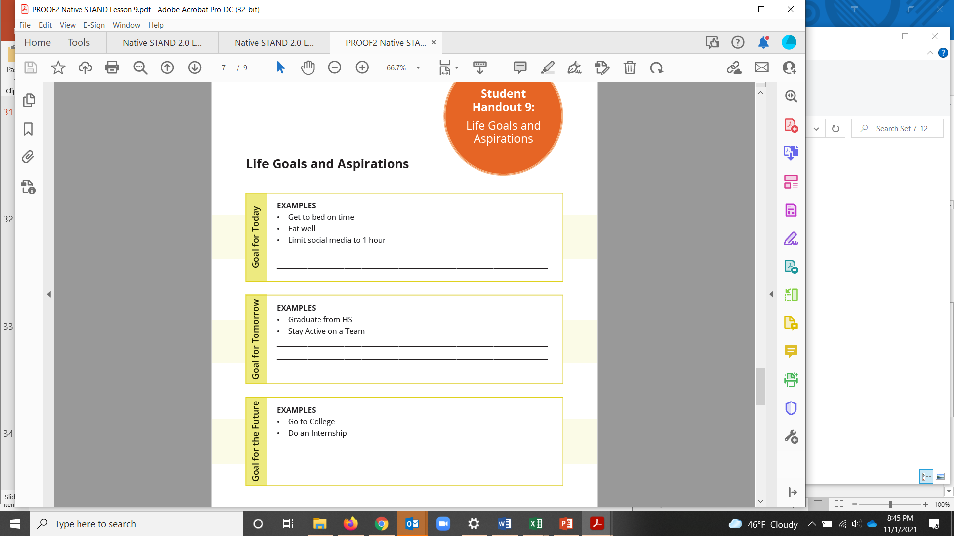

Slide 35
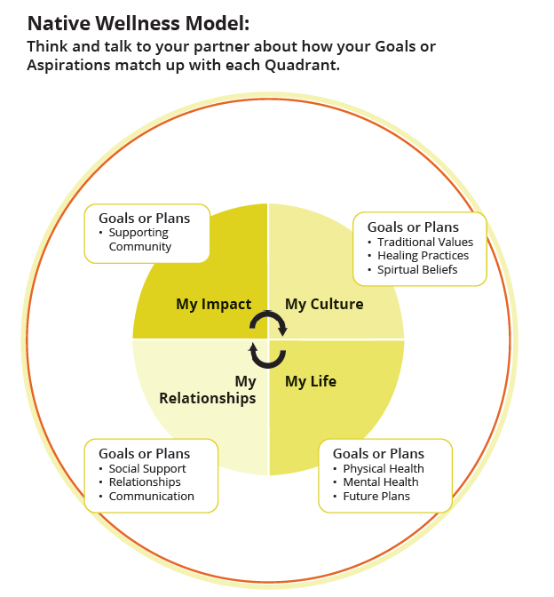

Slide 36
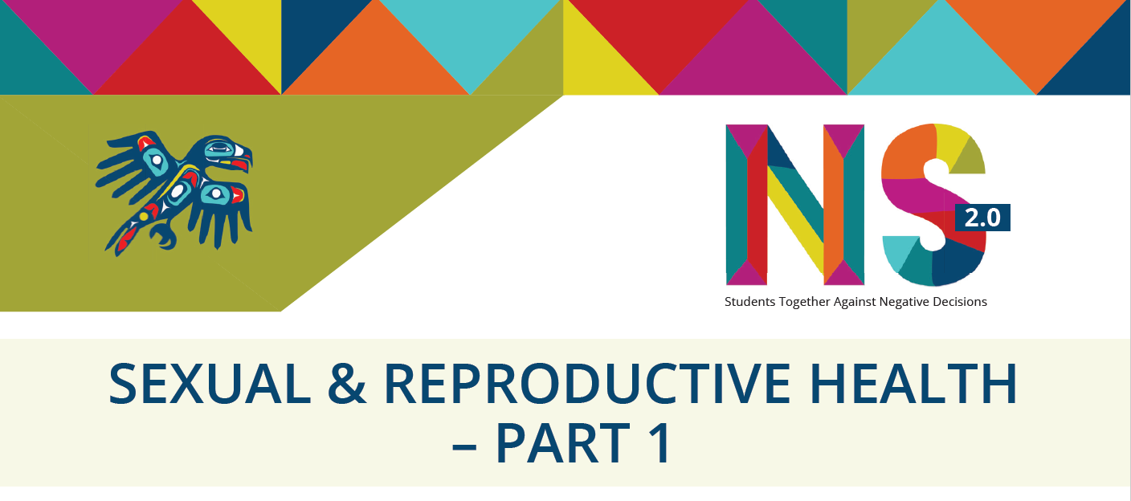
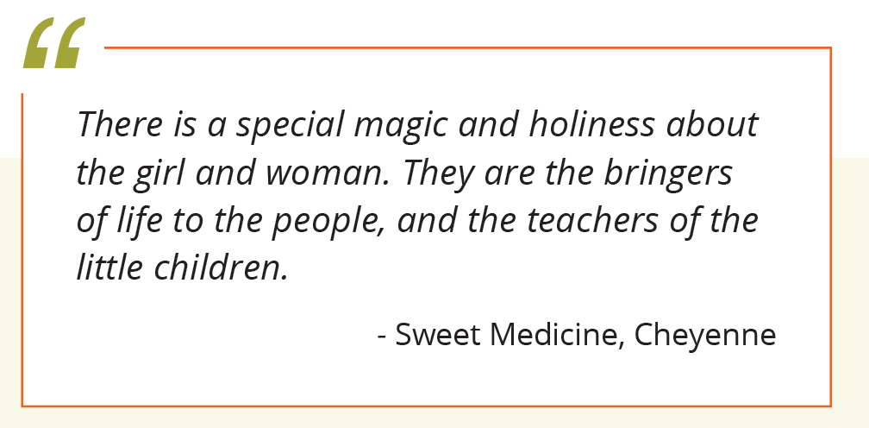

Slide 37
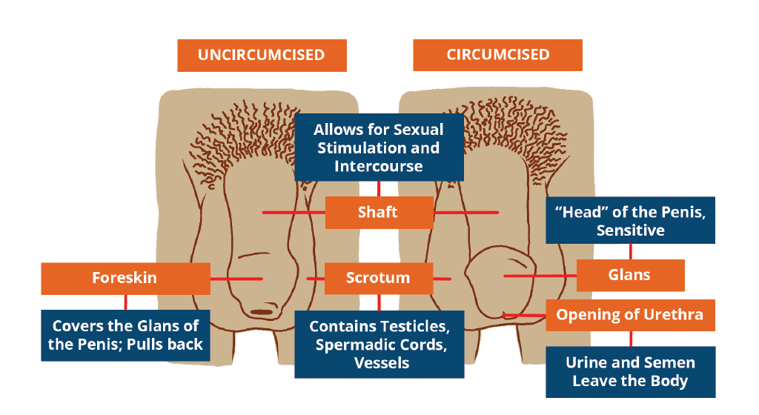
Notes:
Describe these components:
• Shaft: allows for sexual stimulation and sex
• Scrotum: contains testicles
• Foreskin: covers the glans of the penis (if not circumcised)
• Glans: “head” of the penis
• Opening of urethra: urine and semen leave the body through this opening
• Pubic hair
• Point out that some penises are circumcised and some are uncircumcised. Circumcision is removal of the foreskin, and it is usually performed shortly after birth. Let the students know that people can be healthy and normal, whether or not they are circumcised.
• Mention also that most people with penises also have one testicle that hangs lower than the other. The size of testicles can also differ at times due to the temperature, your age, or surgery.

Slide 38
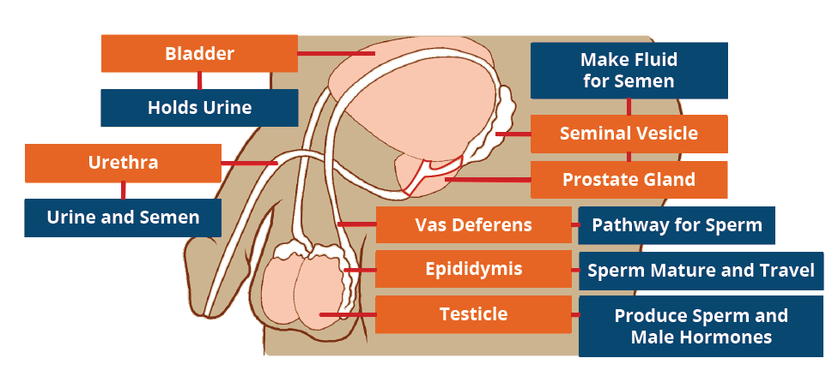
Notes:
Describe these components:
• Bladder: holds urine
• Urethra: urine and semen leave body through this pathway
• Seminal Vesicles: makes fluid for semen
• Prostate Gland: makes fluid for semen
• Vas Deferens: pathway for sperm
• Epididymis: sperm mature and travel through this organ
• Testicles: produce sperm and hormones
• Project the diagram on the white board and use a dry erase marker to trace the path that sperm take from the testes, through the epididymis and vas deferens, over and behind the bladder, through the prostate gland, into the urethra, through the penis and out the tip of the penis with ejaculation.

Slide 39
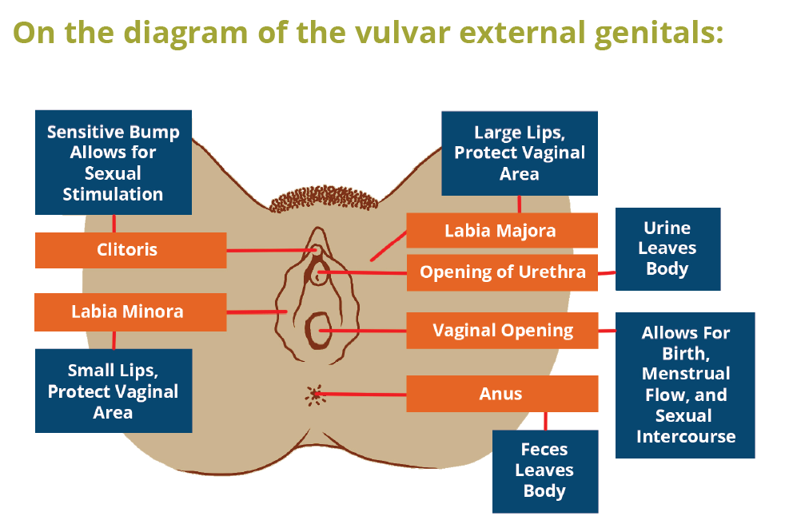
Notes:
Describe these components:
• Clitoris: sensitive bump that allows for sexual stimulation
• Labia Minora: small “lips,” protect vaginal area
• Labia Majora: large “lips,” protect vaginal area
• Opening of urethra: urine leaves body through this opening
• Opening of vagina: allows for birth, menstrual flow, and sex
• Anus: feces leaves body through this opening
• Point out the opening of the vagina, and let the class know that some people have a hymen, i.e., tissue around the opening (leftover from embryonic development).
• For many people with vaginas, this tissue is stretched, thinned over time, or broken when they first use tampons, or ride bikes or horses. When this tissue is first broken or stretched, they can have some bleeding or pain.
• Some people have very little to no hymen tissue and have no bleeding or pain when they first engage in penetrative sexual activity (i.e. fingering, penetration, etc.). Everyone’s bodies are unique.

Slide 40
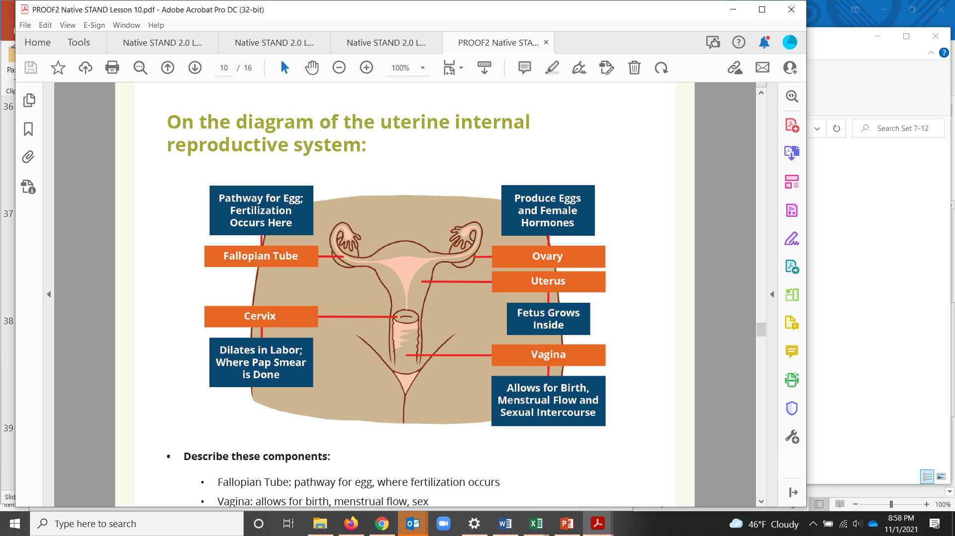
Notes:
Describe these components:
• Fallopian Tube: pathway for egg, where fertilization occurs
• Vagina: allows for birth, menstrual flow, sex
• Uterus: fetus grows inside
• Ovary: produce eggs and hormones
• Cervix: opening to uterus, dilates in labor, where a Pap Smear is done
• Trace the path that the egg takes from the ovary, through the Fallopian tube, into the uterus. Then, if it has not been fertilized (in the tube), the egg goes with the menstrual blood flow through the cervix, and through the vagina to the outside of the body.
• If the egg is fertilized, this happens shortly after ovulation (when the egg is released from the ovary). Fertilization of the egg by the sperm occurs in the Fallopian tube. The fertilized egg takes about a week to travel to the uterus, and then it implants in the uterine lining to begin a pregnancy. If fertilization and implantation are successful, the female will usually not have menstrual bleeding. A “missed” or “late” period is one of the symptoms of early pregnancy.
• Having some discharge from the vagina is totally normal! If things change – like the color, texture or smell – reach out to a care provider.

Slide 41


Slide 42


Slide 43



Slide 44



Slide 45


Slide 46
Notes:
The Journey of the Sperm & Egg
1. Sperm (START HERE)
2. Testicle
3. Epididymis
4. Vas Deferens
5. Urethra
6. Vagina
7. Cervix
8. Uterus
9. Fallopian tubes
10. Ovary
11. Egg (end here)

Slide 47
Notes:
The Journey of the Sperm & Egg
1. Sperm (START HERE)
2. Testicle
3. Epididymis
4. Vas Deferens
5. Urethra
6. Vagina
7. Cervix
8. Uterus
9. Fallopian tubes
10. Ovary
11. Egg (end here)

Slide 48


Slide 49



Slide 50

Notes:
Sort the activities into the correct risk group.

Slide 51
Answer Key

Slide 52



Slide 53


Slide 54


Slide 55


Slide 56

https://youtu.be/whdC7hD-btE

Slide 57

https://youtu.be/gwr4inj5jb4
Notes:
Practice: How to Use a Dental Dam and External Condom
10 minutes, Individual Activity
How to Use a Condom: https://youtu.be/gwr4inj5jb4
How to Make a Dental Dam: https://youtu.be/V6WBsXiul0Q

Slide 58

https://youtu.be/V6WBsXiul0Q
Notes:
Practice: How to Use a Dental Dam and External Condom
10 minutes, Individual Activity
How to Use a Condom: https://youtu.be/gwr4inj5jb4
How to Make a Dental Dam: https://youtu.be/V6WBsXiul0Q

Slide 59


Slide 60



Slide 61

https://youtu.be/_459D9D55Zk
Notes:
Play Episode 2: https://youtu.be/_459D9D55Zk
Play Episode 3: https://youtu.be/b4VaiqUEUfg

Slide 62

https://youtu.be/b4VaiqUEUfg
Notes:
Play Episode 2: https://youtu.be/_459D9D55Zk
Play Episode 3: https://youtu.be/b4VaiqUEUfg

Slide 63


Slide 64


Slide 65

Text SEX to 94449

Slide 66



Slide 67

https://www.youtube.com/watch?v=YxfOu_aTzH8

Slide 68



Slide 69



Slide 70



Slide 71



Slide 72


Slide 73


Slide 74

Notes:
Sometimes all it takes is a thoughtful text to brighten your day and shift your perspective. We all need a little more joy in our lives, and We R Native wants to help spread the love.
Simply text “CARING’’ to 65664 to receive two texts per week with funny videos, songs, and messages designed to improve your mood and remind you of just how awesome you are!
The best part about being Native, is that we have each other’s backs. Consider signing up to get an extra boost from relatives and relations who care.

Slide 75



Slide 76

https://youtu.be/6E6TZlkJW44
Notes:
Briefly discuss their reactions to the video clip.
Ask: What events in Alex’s life affected his decision to drink?
How did Alex’s alcohol use affect his behavior toward Chris?
Were any other character’s actions affected by alcohol use?
What actions did Benny take, that helped Alex get the help he needed?

Slide 77


Slide 78



Slide 79

+’s and –’s

Slide 80

Our Relationships
Our Lives
Our Impact
Our Culture

Slide 81

Funding Credit
Our projects are funded by the Indian Health Service HIV and behavioral health programs. This work is also supported with funds from the Minority AIDS Initiative Fund.

Slide 82
Where to Find us ☺
NPAIHB

Slide 83

Place your screenshot here
For Adults: Text “EMPOWER” to 97779
Tips & Resources for Talking to Youth About Sexual Health
Need some help getting the convo started?
Notes:
Include animatics link

Slide 84

Sign up for the Healthy Native Youth Newsletter!
Stay up to Date with the Latest!
Place your screenshot here

Slide 85
Northwest Portland Area Indian Health Board
Stephanie Craig Rushing, PhD, MPH
Principal Investigator
scraig@npaihb.org
Jessica Leston, MPH
STD/HIV Clinical Services Director
jleston@npaihb.org
Colbie Caughlan, MPH
THRIVE Project Director
ccaughlan@npaihb.org
Celena McCray, MPH
WYSH Manager
cmccray@npaihb.org
Roger Peterson
Text Messaging Specialist
rpeterson@npaihb.org
Amanda Gaston, MAT
Ask Auntie
agaston@npaihb.org
Lael Tate
THRIVE Project Coordinator
ltate@npaihb.org
Tommy Ghost Dog
We R Native Coordinator
tghostdog@npaihb.org
Michelle Singer
Healthy Native Youth Manager
msinger@npaihb.org
Paige Smith
Youth Engagement Coordinator
psmith@npaihb.org
Morgan Thomas
2SLGBTQ Outreach Coordinator
mthomas@npaihb.org
Corey Begay
Multimedia Specialist
cbegay@npaihb.org
Jane Manthei
Healthy Native Youth Outreach
jmanthei@npaihb.org
Asia Brown
Sexual Health Communications
ambrown@npaihb.org

