Slide 1
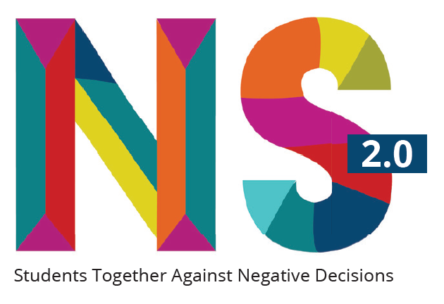

Slide 2
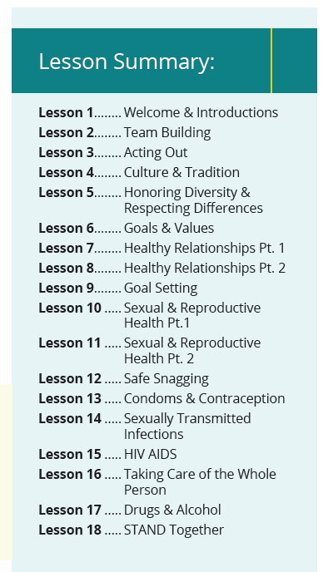

Slide 3
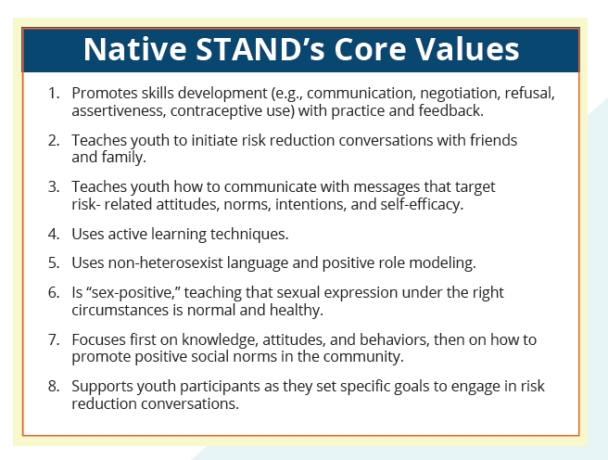

Slide 4
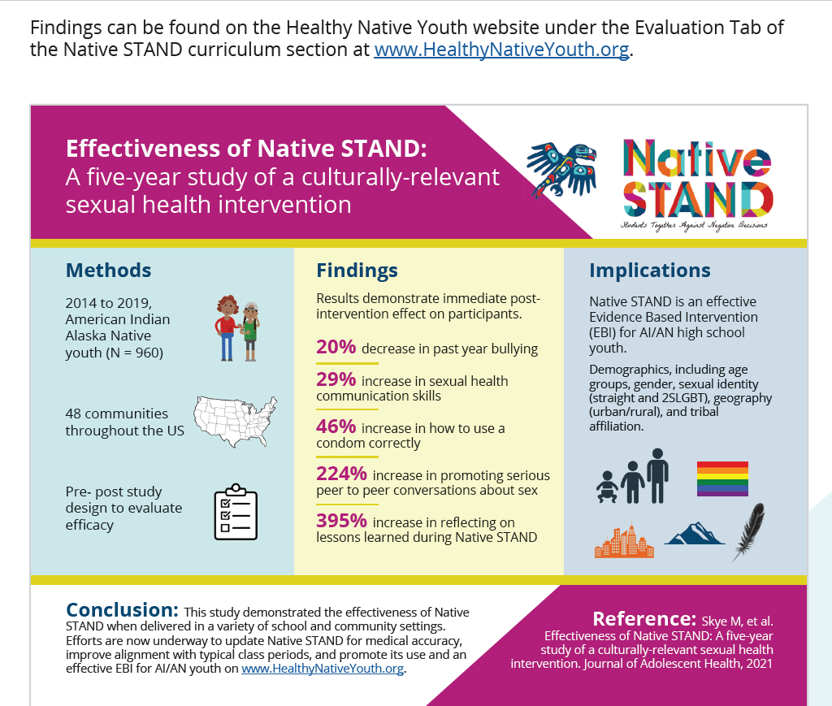

Slide 5
Native STAND 2.0
What’s New?

Slide 6
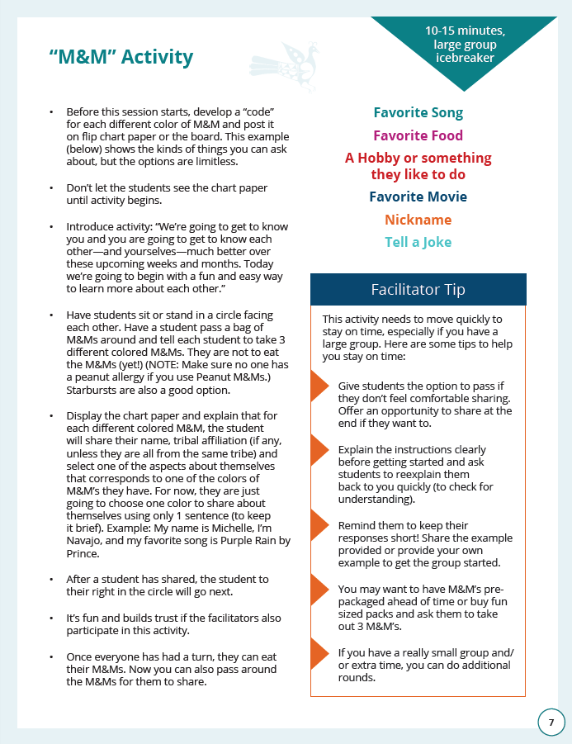
Lesson Instructions:
Updated/ Modernized Content
Less packed with content
Fewer handouts to print
Increased inclusion & student engagement
Clearly marked Facilitator Tips to support flexible adaptation options
Timing & Instructional Methods are clearly marked

Slide 7
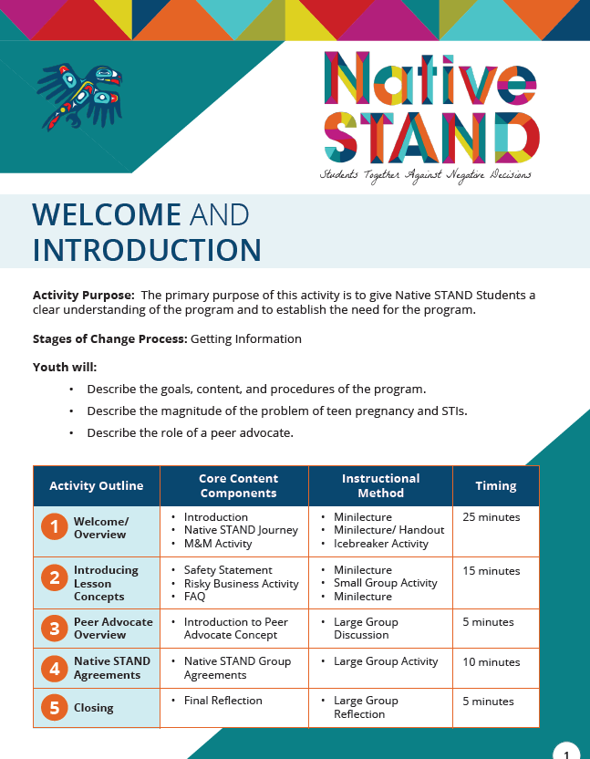
Lesson Overview Page:
includes outline & updated timing so all lessons are 45-50 minutes long

Slide 8
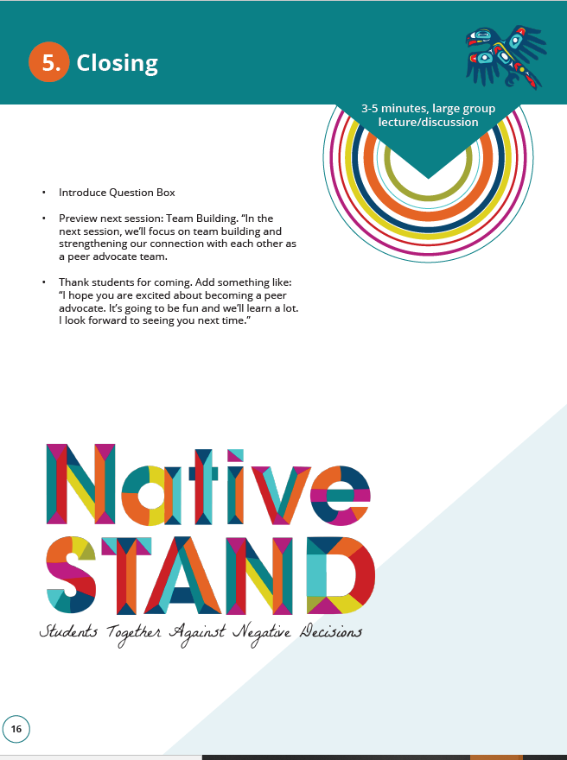
Opening & Closing
Open & Close lessons consistently throughout curriculum
Trauma Informed Updates to help youth prepare for next lesson
Engage youth reading/ reflecting on the WOW
Updated WOWs include a wider range of cultures/ tribes and connect more to the lesson content.

Slide 9
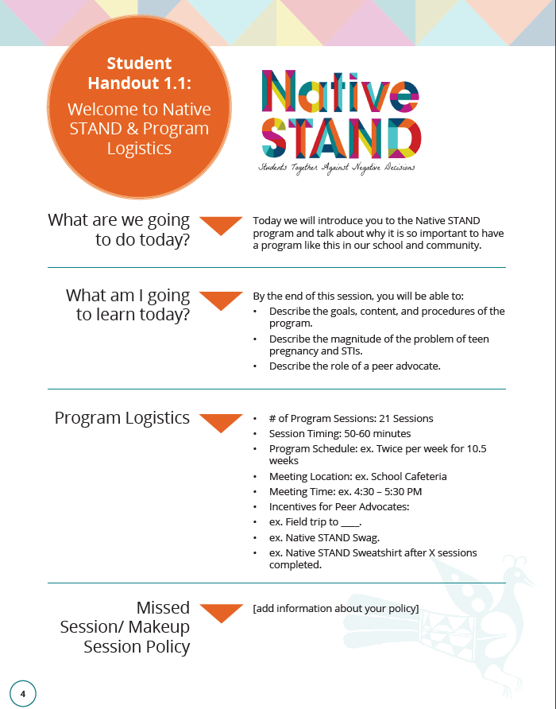
Student Handouts are easy to recognize in the Curriculum

Slide 10
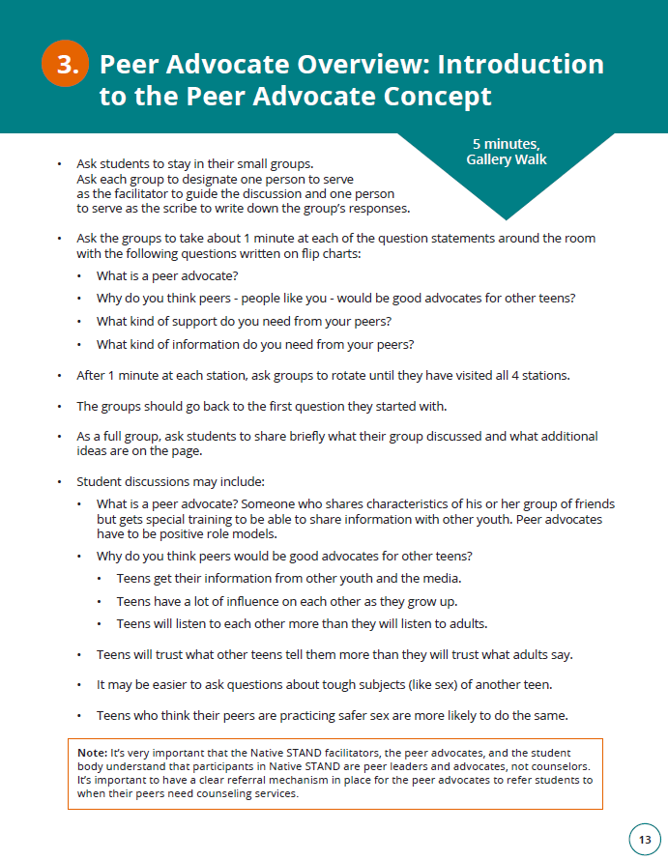
Peer Educator → Peer Advocate
Better aligned to the way most facilitators implemented the program
Less pressure on students to have a formal role/ present with adult facilitator
Connects participants to their role as a positive peer influencer

Slide 11
Native STAND 2.0
Where to Find Us…

Slide 12




Slide 13
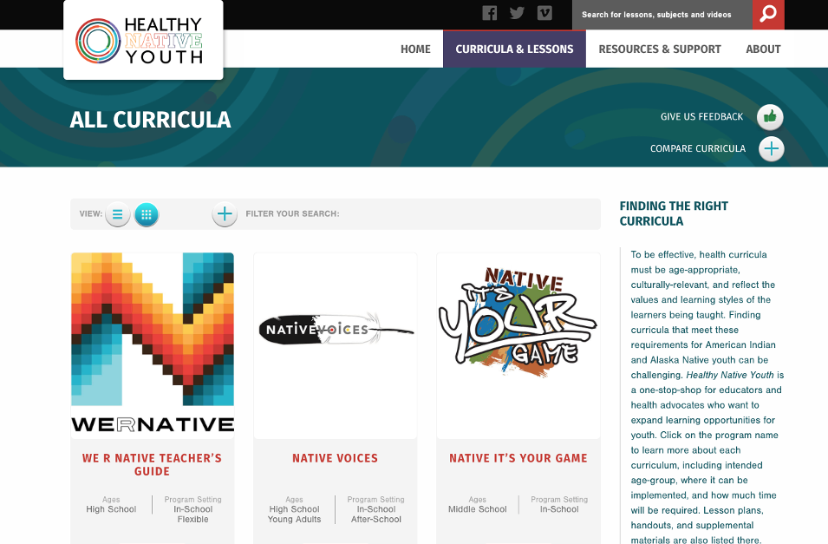
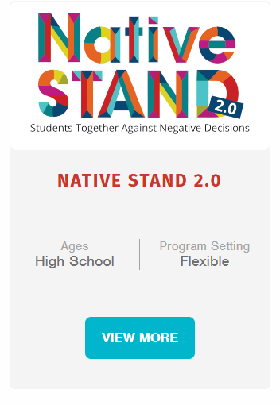
Notes:
Overview of curricula including new curricula…

Slide 14
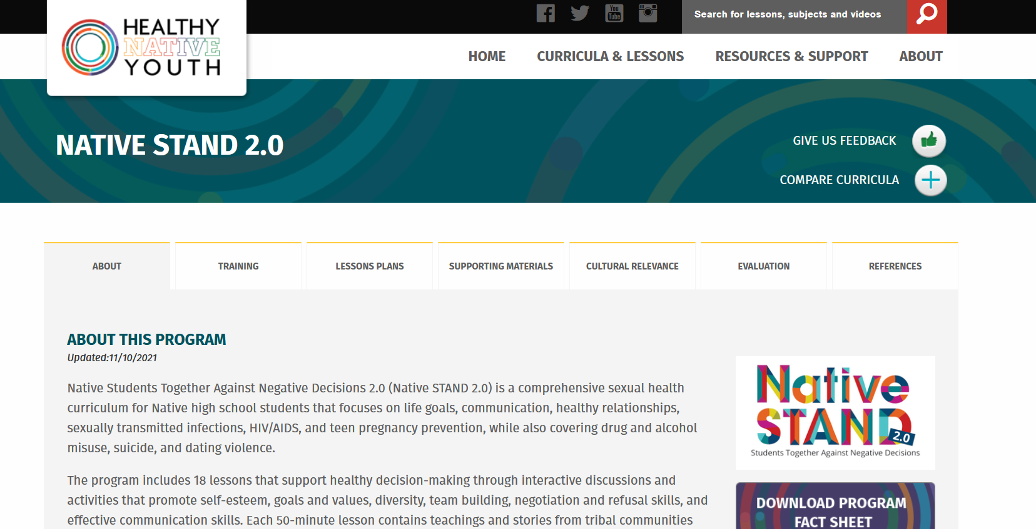

Slide 15
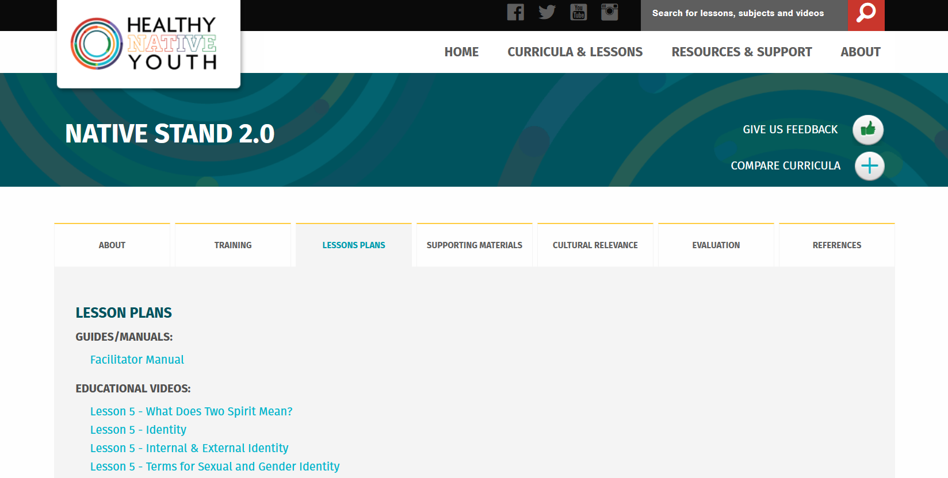

Slide 16
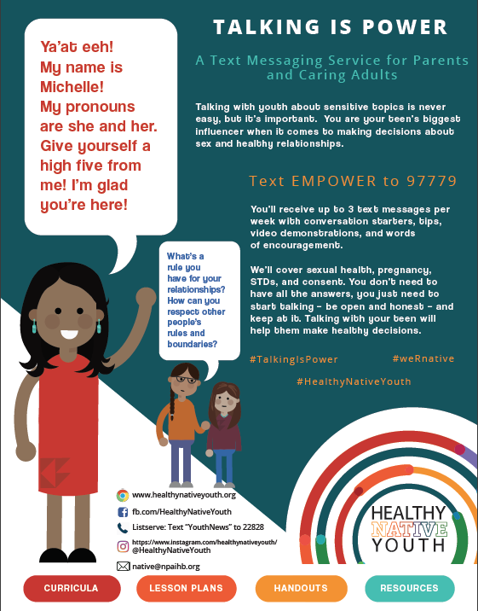
Place your screenshot here
For Adults: Text “EMPOWER” to 97779
Tips & Resources for Talking to Youth About Sexual Health
Need some help getting the convo started?
Notes:
Include animatics link

Slide 17
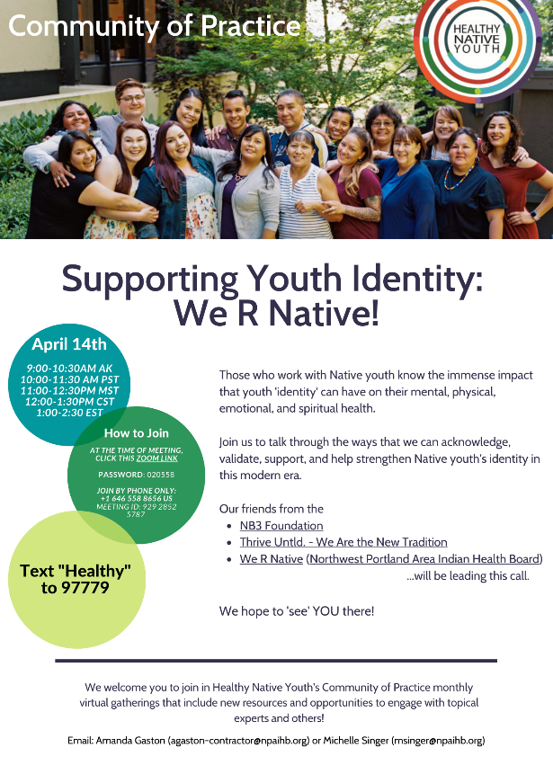
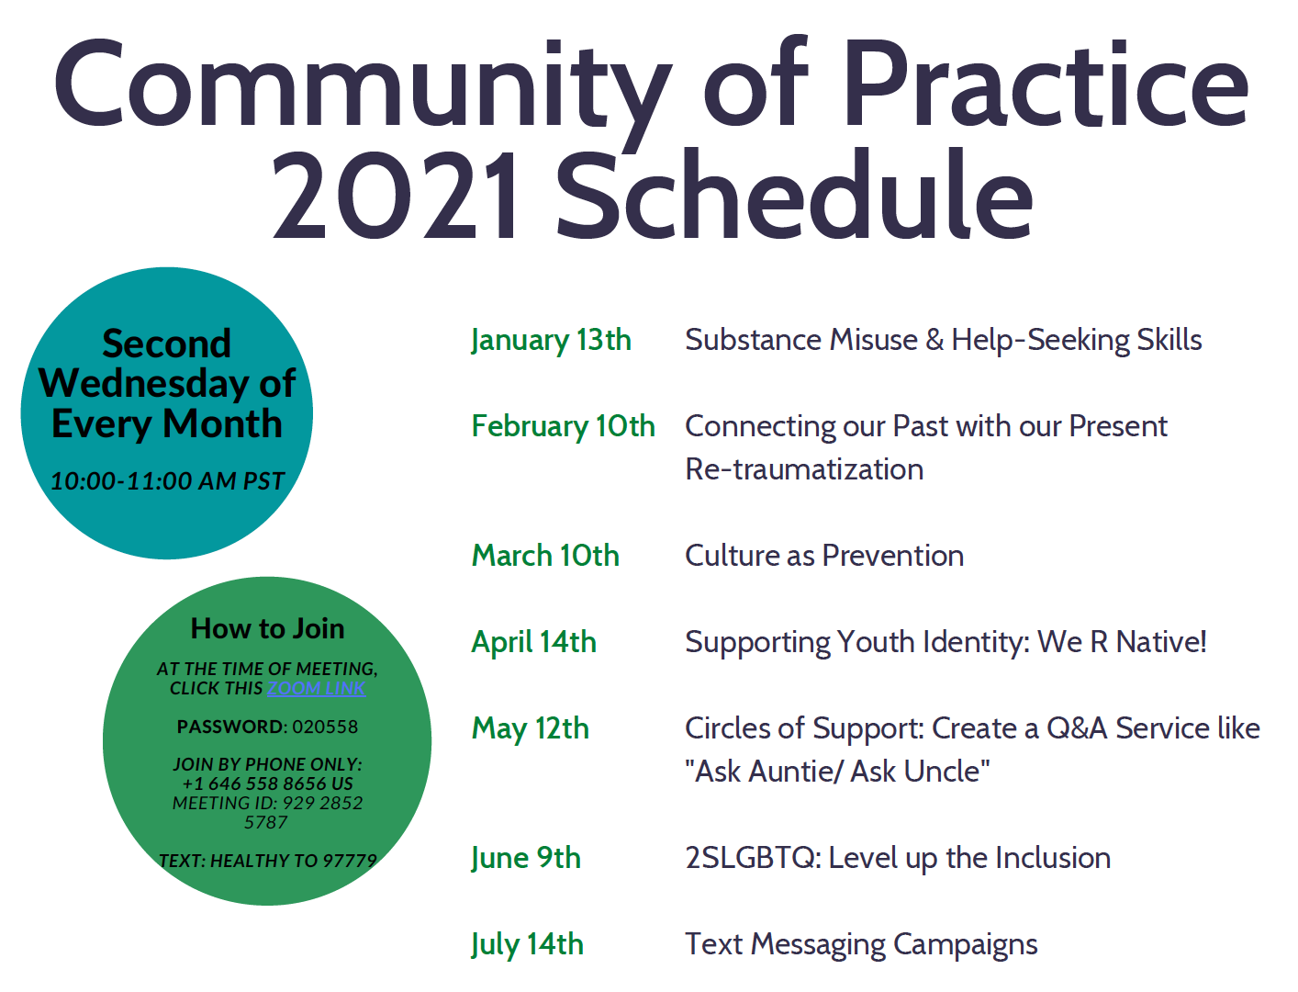

Slide 18
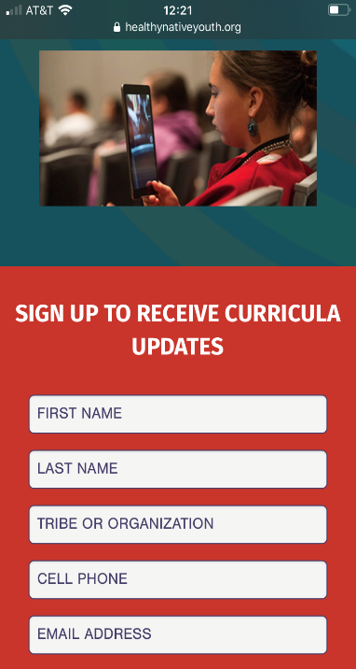
Sign up for the Healthy Native Youth Newsletter!
Stay up to Date with the Latest!
Place your screenshot here

Slide 19

Funding Credit
Our projects are funded by the Indian Health Service HIV and behavioral health programs. This work is also supported with funds from the Minority AIDS Initiative Fund.

Slide 20
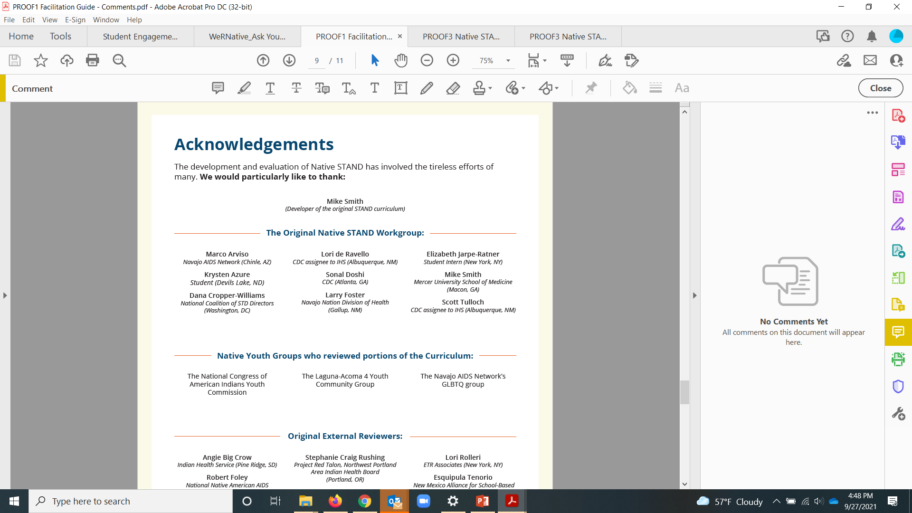

Slide 21
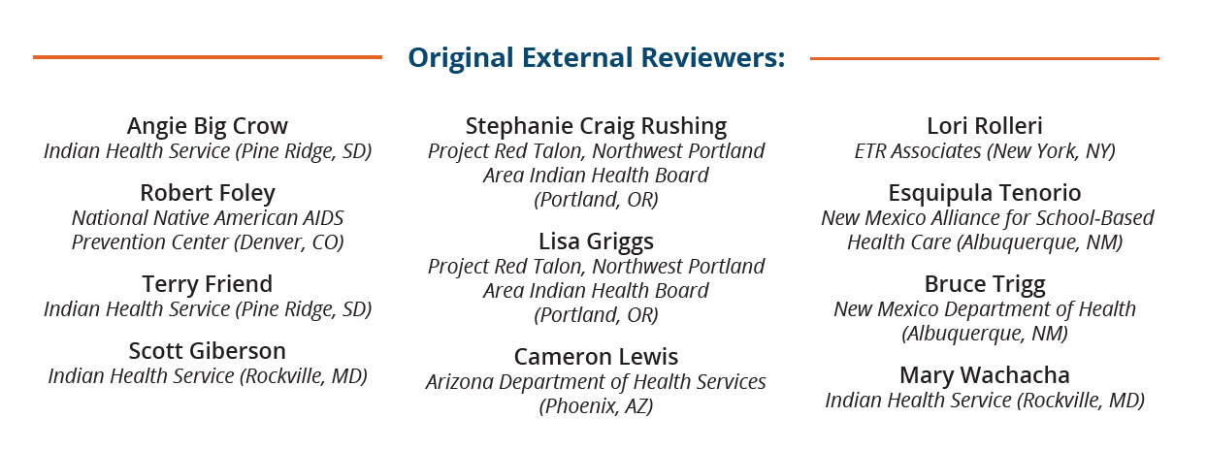

Slide 22
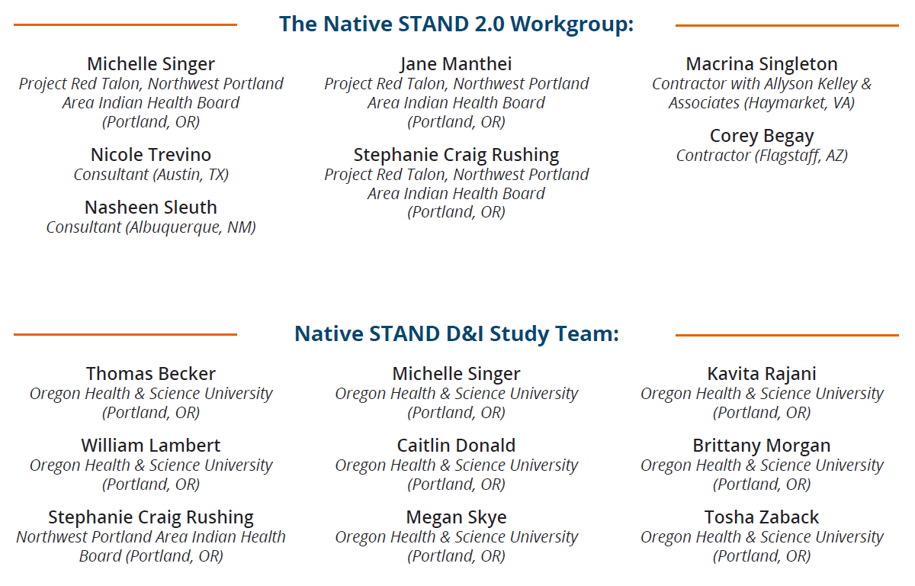

Slide 23
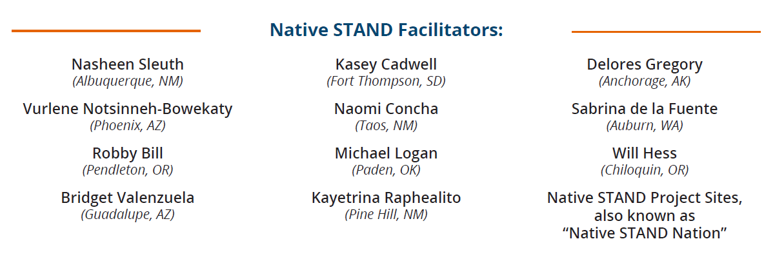

Slide 24
Where to Find us ☺
NPAIHB

Slide 25
Northwest Portland Area Indian Health Board
Stephanie Craig Rushing, PhD, MPH
Principal Investigator
scraig@npaihb.org
Jessica Leston, MPH
STD/HIV Clinical Services Director
jleston@npaihb.org
Colbie Caughlan, MPH
THRIVE Project Director
ccaughlan@npaihb.org
Celena McCray, MPH
WYSH Manager
cmccray@npaihb.org
Roger Peterson
Text Messaging Specialist
rpeterson@npaihb.org
Amanda Gaston, MAT
Ask Auntie
agaston@npaihb.org
Lael Tate
THRIVE Project Coordinator
ltate@npaihb.org
Tommy Ghost Dog
We R Native Coordinator
tghostdog@npaihb.org
Michelle Singer
Healthy Native Youth Manager
msinger@npaihb.org
Paige Smith
Youth Engagement Coordinator
psmith@npaihb.org
Morgan Thomas
2SLGBTQ Outreach Coordinator
mthomas@npaihb.org
Corey Begay
Multimedia Specialist
cbegay@npaihb.org
Jane Manthei
Healthy Native Youth Outreach
jmanthei@npaihb.org
Asia Brown
Sexual Health Communications
ambrown@npaihb.org

