Slide 1
Native VOICES: A Video-based Sexual Health Intervention for American Indian Teens and Young Adults
Notes:
Anyone who lives or works in Indian Country knows that discussing sex or sexual health is a difficult thing for our young people.

Slide 2
Native VOICES Study Goals
Improve our understanding of sexual norms and risk/protective factors among Native youth
Produce an evidence-based HIV/STD intervention that addresses the unique needs of Native youth
Offer AI/AN communities a cost-effective sexual health intervention that could be readily integrated into existing programs/services and easily transferrable across Indian Country.
Notes:
The study was carried out by the Northwest Portland Area Indian Health Board, with support from the Native American Research Center for Health (NARCH).

Slide 3
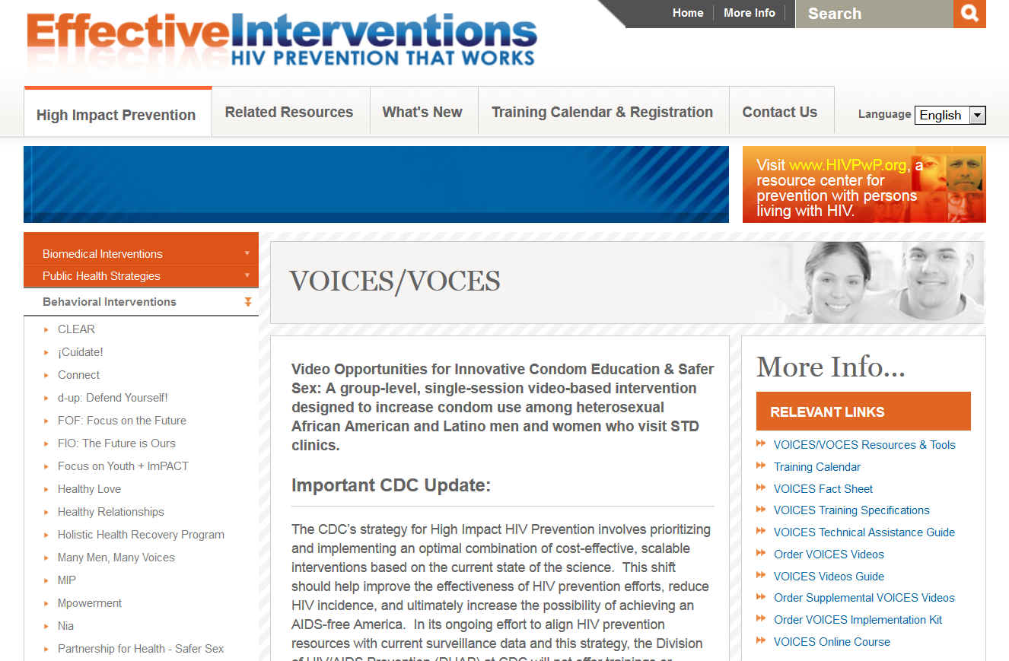
Notes:
Native VOICES was adapted from Video Opportunities for Innovative Condom Education and Safer Sex (VOICES), a video-based intervention recognized by the Centers for Disease Control and Prevention (CDC): https://www.effectiveinterventions.org/en/HighImpactPrevention/Interventions/VOICES.aspx
Eight Supplemental VOICES Videos have been approved by the CDC for use as alternative videos for the Intervention.

Slide 4
Adaptation Process : 2011 - 2012
Background, Social/Cultural Norms & Knowledge
Focus Groups: AI Teens and Young Adults
Interviews: Clinic Staff
Interviews: Two Sprit Youth
Analyze
FLO-0187-2DM-5N
Notes:
Adaptation Process: To maximize the cultural appropriateness of the Native VOICES video, the Northwest Portland Area Indian Health Board conducted 8 focus groups with NW Native youth, 10 interviews with clinical staff and staff at youth-serving organizations, and 13 interviews with youth who identified as LGBTQ/TS (lesbian, gay, bisexual, transgendered, or queer, or two spirit) using community-based participatory research strategies.
The findings from these focus groups were compiled in a report, available on the www.npaihb.org website.

Slide 5
Changes to Improve Cultural Appropriateness
Original | Native VOICES | Youth Rationale
Major scene locations include a bar, upscale restaurant, pharmacy, and a hair salon. | Major scene locations include a basketball court, private homes, and a supermarket. | Scene locations need to better reflect the spaces occupied by Native youth.
Discussions about STDs and safer sex occur in public spaces. | Discussions about STDs and safer sex occur in private spaces or public spaces where characters are alone. | It would be “awkward“ to have this conversation about sex in public where others might overhear you.
Promotion of condoms as a safer sex tool. | Promotion of both condoms and dental dams as safer sex tools. | Needed to better meet the sexual health needs of youth.
Characters openly discuss the pleasure of sex. | Specific lines regarding sexual pleasure were removed and conversations were softened regarding sexual desire. | Men and women discussing the pleasure of sex made several teens feel uncomfortable.
Notes:
Like IYG, we used Resnicow’s research to prioritize surface and deep cultural adaptations.
For example, some of our Surface-Level adaptations included that:
Major scene locations were changed to better reflect spaces occupied by Native youth
Native teens don’t flirt as openly and as confidently as the adults portrayed in the original video.
Participants felt that humor should be used to intiate conversations about sex and keep them lively.

Slide 6
Changes to Improve Cultural Appropriateness
Original | Native VOICES | Youth Rationale
Dialogue between friends discussing safer sex are at times serious and weighty. | When youth talk with each other about sex, they use humor. Dialogue is generally kept light. | Use humor to intiate conversations about sex and keep them lively.
Eddie’s friend brings him to a drug store to show him the different kinds of condoms and encourages him to buy condoms. | Jamie, along with his brother and a friend go to a large urban supermarket to buy condoms using self-checkout. | Participants recommended that the characters use self-checkout, a less intimidating option than buying condoms from a cashier or being seen getting them at a free clinic or pharmacy, where you might be seen.
Eddie and Joanna have unprotected sex after their first date at a restaurant. | Jamie and Christina have unprotected sex after drinking at a house party. | Need to demonstrate the effect of drinking & drugs on decision-making.
Notes:
As an example of a Deep Adaptation
The original characters have unprotected sex after their first date at a restaurant.
The Native VOICES characters have unprotected sex after drinking at a house party.
Youth and adult stakeholders both thought the Native VOICES video should demonstrate the effect of drinking & drugs on decision-making.

Slide 7
Changes to Improve Cultural Appropriateness
Original | Native VOICES | Youth Rationale
No LGBT or Two Spirit characters. | Several LGBT/two spirit characters, including one of the main characters. The message that “two girls - or two guys - can give each other STDs” is featured. | Must include LGBT/Two Spirit characters to be more realistic, and reflect a diversity of perspectives.
No LGBT or Two Spirit positive role models. | Tyler, Christina’s friend who is living with his male partner, is respected in the community, successful, and connected. He participates in safer sex behavior and is in a healthy, happy same-sex relationship. | Need to include positive role models who can inspire gay youth to protect themselves and model healthy same-sex relationships. Must be involved, tied to their culture, and valued by their community.
Notes:
Surface/Deep
No LGBT or Two Spirit characters.
Several LGBT/two spirit characters, including one of the main characters. The message that “two girls - or two guys - can give each other STDs” is featured.
Need to include positive LGBT role models who can inspire gay youth to protect themselves and model healthy same-sex relationships. Must be involved, tied to their culture, and valued by their community.

Slide 8
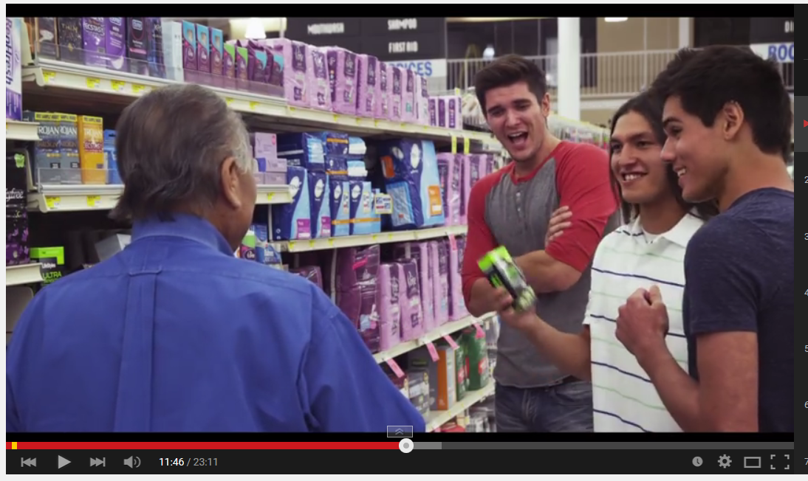
www.youtube.com
Notes:
During the third year of the project, Native teens and young adults from across the U.S. read or reenacted iterative drafts of the adapted script, and provided feedback on the characters, scenes, tone, and dialogue.
The adapted Native VOICES video was shot on location in Oklahoma City in August 2013.

Slide 9
National Effectiveness Study – 2014
  Recruited and trained 8 sites (16 site coordinators), located across the U.S. (urban/rural)
  Randomized Sites into 3 Study Arms
  Native VOICES w/ a facilitator
  Native VOICES video alone
  We R Native sexual health fact sheets
Notes:
In 2014 we worked with 8 tribes and tribal organizations across the U.S. to evaluate the effectiveness of the Native VOICES intervention.
The sites were randomized into one of three study arms:

Slide 10
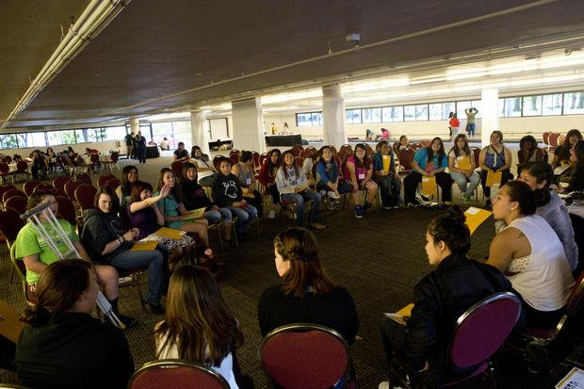
Notes:
Changes in participant knowledge, attitude, intention and behavior were evaluated using pre-, post-, and 6 month follow-up surveys.

Slide 11
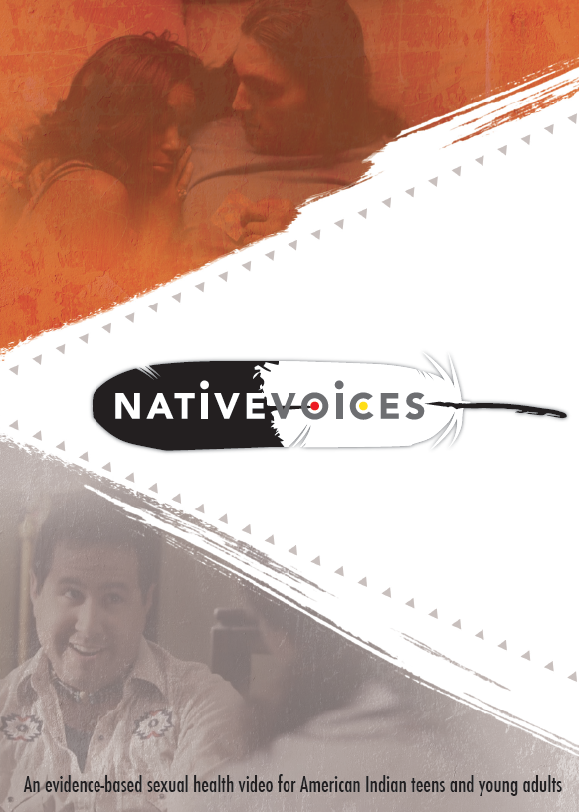
Video Satisfaction:
  93% - found the video to be culturally appropriate
  100% - trusted the information
  86% - felt the video’s characters, scenes, and situations were relatable
After watching the video, 82% felt more likely to get tested for STDs/HIV, and 78% felt more likely to use condoms.
Notes:
Participants expressed high levels of satisfaction with the Native VOICES intervention. Over 90% felt the video was culturally appropriate for AI/AN people, 100% trusted the information, and 86% felt the video’s characters, scenes, and situations were relatable.
Statistically significant improvements in sexual health knowledge, attitude, intention, and self-efficacy were demonstrated immediately after the intervention, and were retained after 6 months. Forthcoming analyses will help quantify the impact of the Native VOICES intervention on risk and protective behaviors across the three study arms.

Slide 12
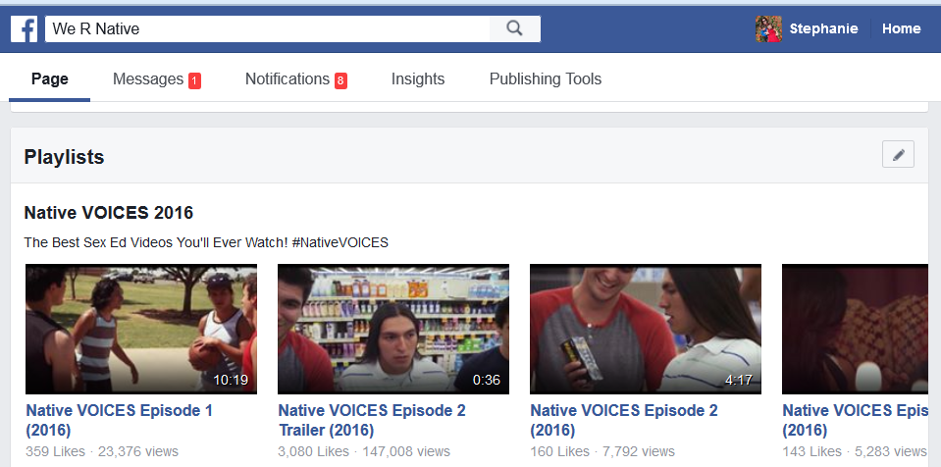
Native VOICES Mini Series
It’s had over 1 million video views on social media!
Notes:
Each year on Valentine’s Day, we release the video as a series of mini-episodes on We R Native’s Facebook page and YouTube channel.

Slide 13
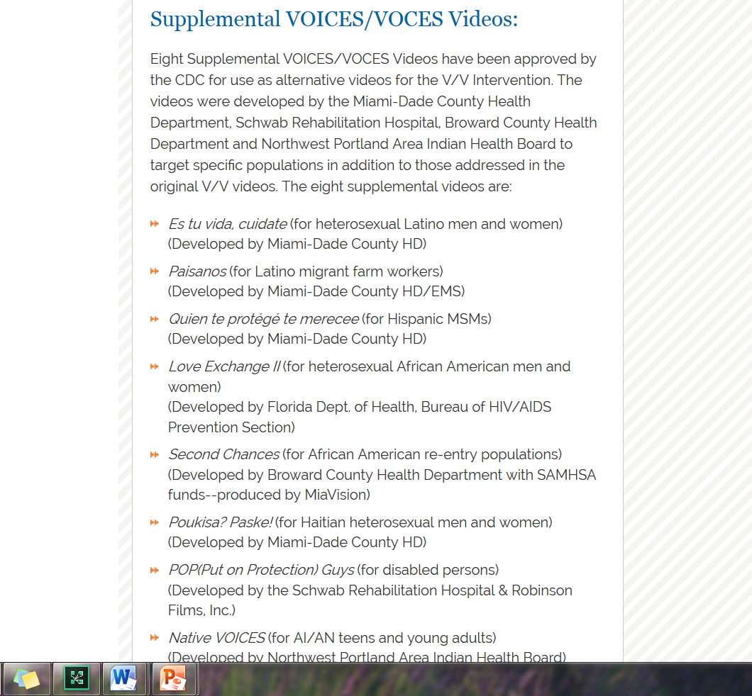
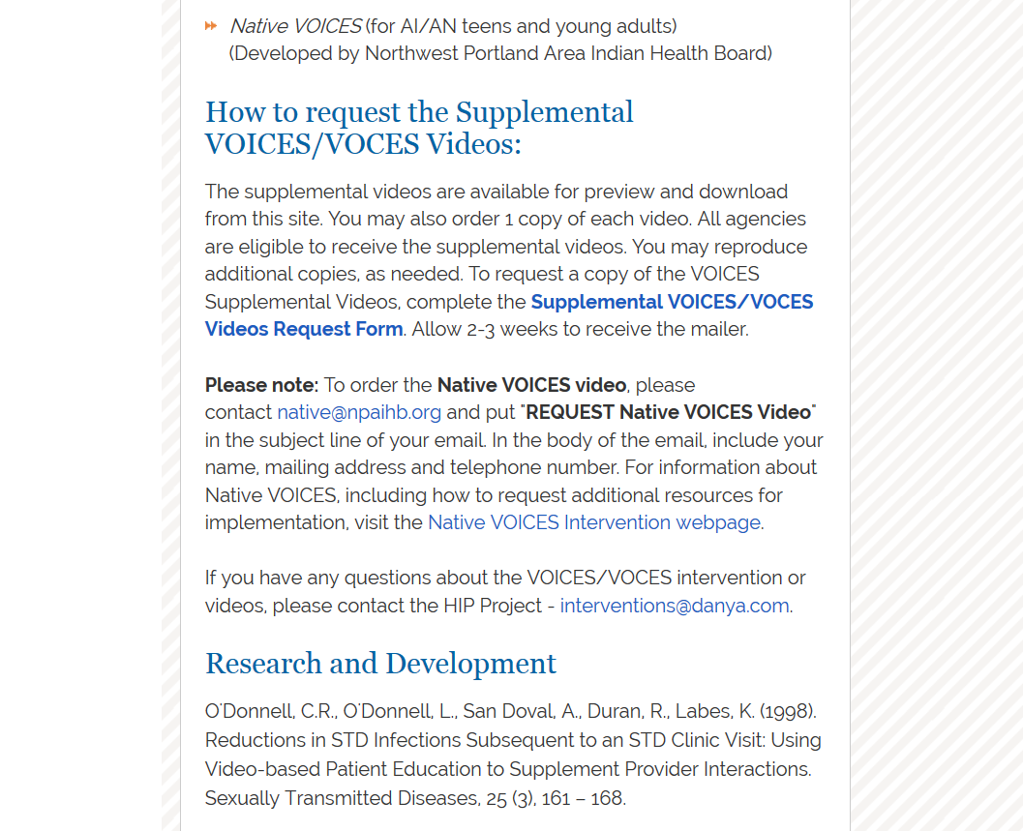
Notes:
As of last month, Native VOICES is the first and only intervention purposefully designed for AI/AN youth included in the CDC’s compendium of effective HIV interventions: https://effectiveinterventions.cdc.gov/en/HighImpactPrevention/Interventions/VOICES.aspx

Slide 14
Native VOICES Toolkit
Native VOICES (23 min)
A condom demonstration video (1:40 minutes)
A dental dam demonstration video (1:08 minutes)
A selection of condoms and dental dams
A users’ guide
Email: native@npaihb.org
Notes:
To support dissemination…

Slide 15
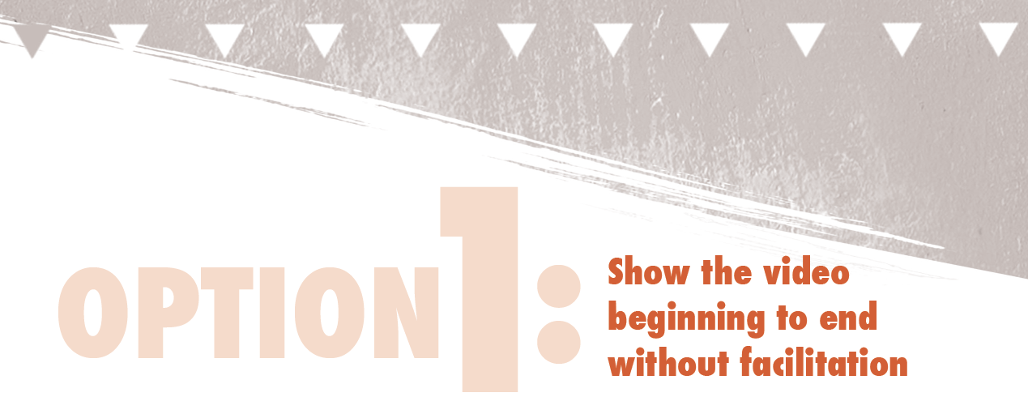
The entire intervention will take 35 minutes & is ideal for individuals or groups with limited time.
Tips: Provide a door prize raffle, drinks and popcorn,
in an environment that is private.

Slide 16
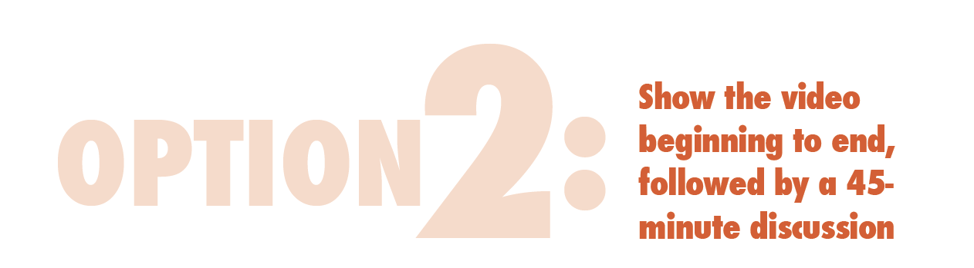
The entire intervention will take approximately 1 hour and 15 minutes, and is ideal for groups requiring a single session intervention.
Notes:
As mentioned before providing a door prize raffle, a beverage and popcorn (or a light snack), and a environment that is private is a great way to engage youth and young adults.
If you look at the users guide on page 10 and 12 you will see the handouts needed for your discussion

Slide 17
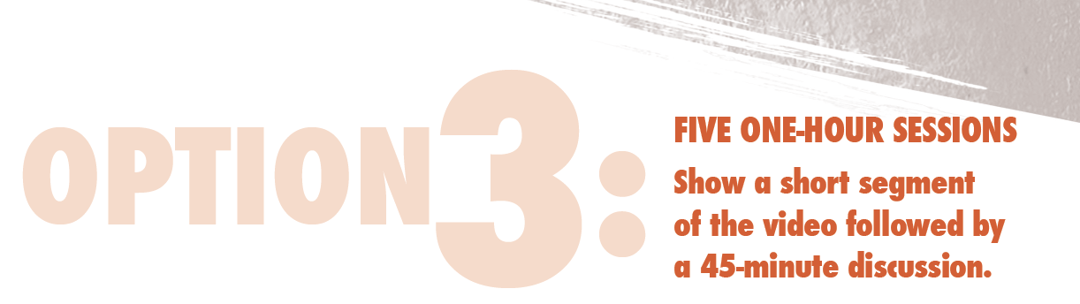
The entire intervention will include five 1-hour sessions. This option is ideal for small or large groups that can meet multiple times.
Notes:
Be sure to ask that the youth and young adults be committed to attending each of the 5 sessions

Slide 18
Other Native VOICES Resources
The toolkit can be ordered free of charge at native@npaihb.org
Please visit our website (www.npaihb.org) for additional resources, including:
  Fact sheets
  Tips for answering sensitive questions
  PowerPoint slides
  Native VOICES “Parent Information Letter”

Slide 19
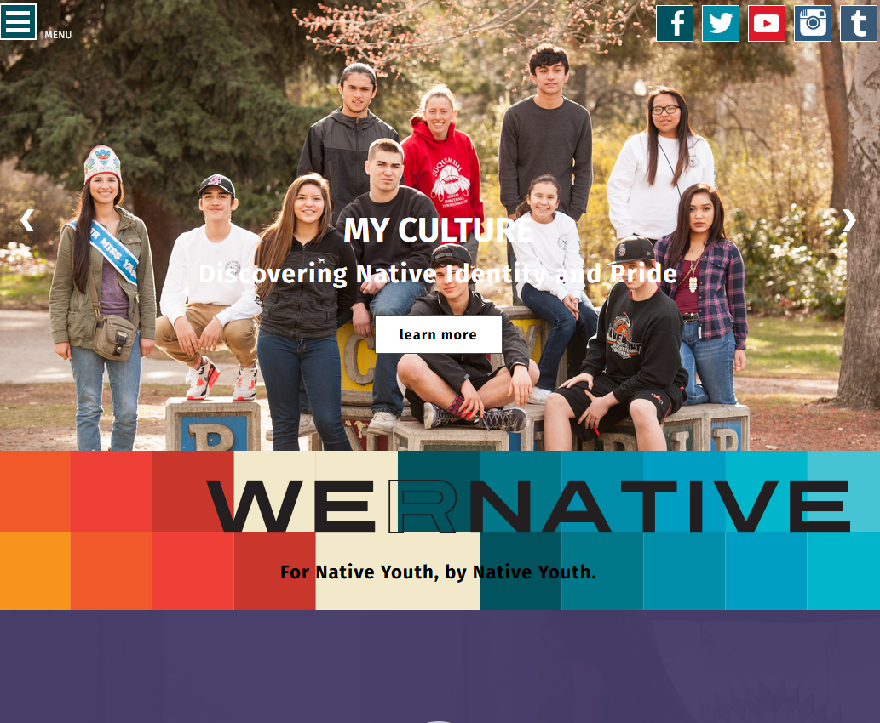
Notes:
The NPAIHB also manages We R Native (a multimedia health resource)…
The service was designed using behavior change theory and extensive formative research with Native youth across the U.S. We design our messages to address the social, structural, and environmental stressors that influence adolescent health. With particular focus given to the prevention of suicide, bullying, STDs, teen pregnancy, and drug and alcohol use.
The project is funded by the Indian Health Service HIV and behavioral health programs, and is heavily supported in-kind by our GLS grant.

Slide 20
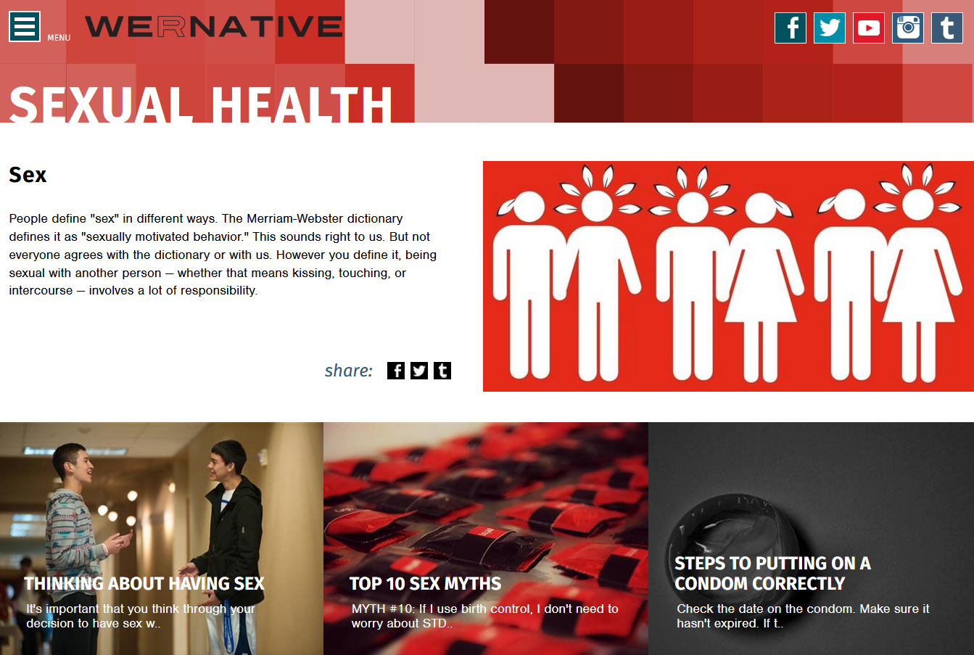

Slide 21
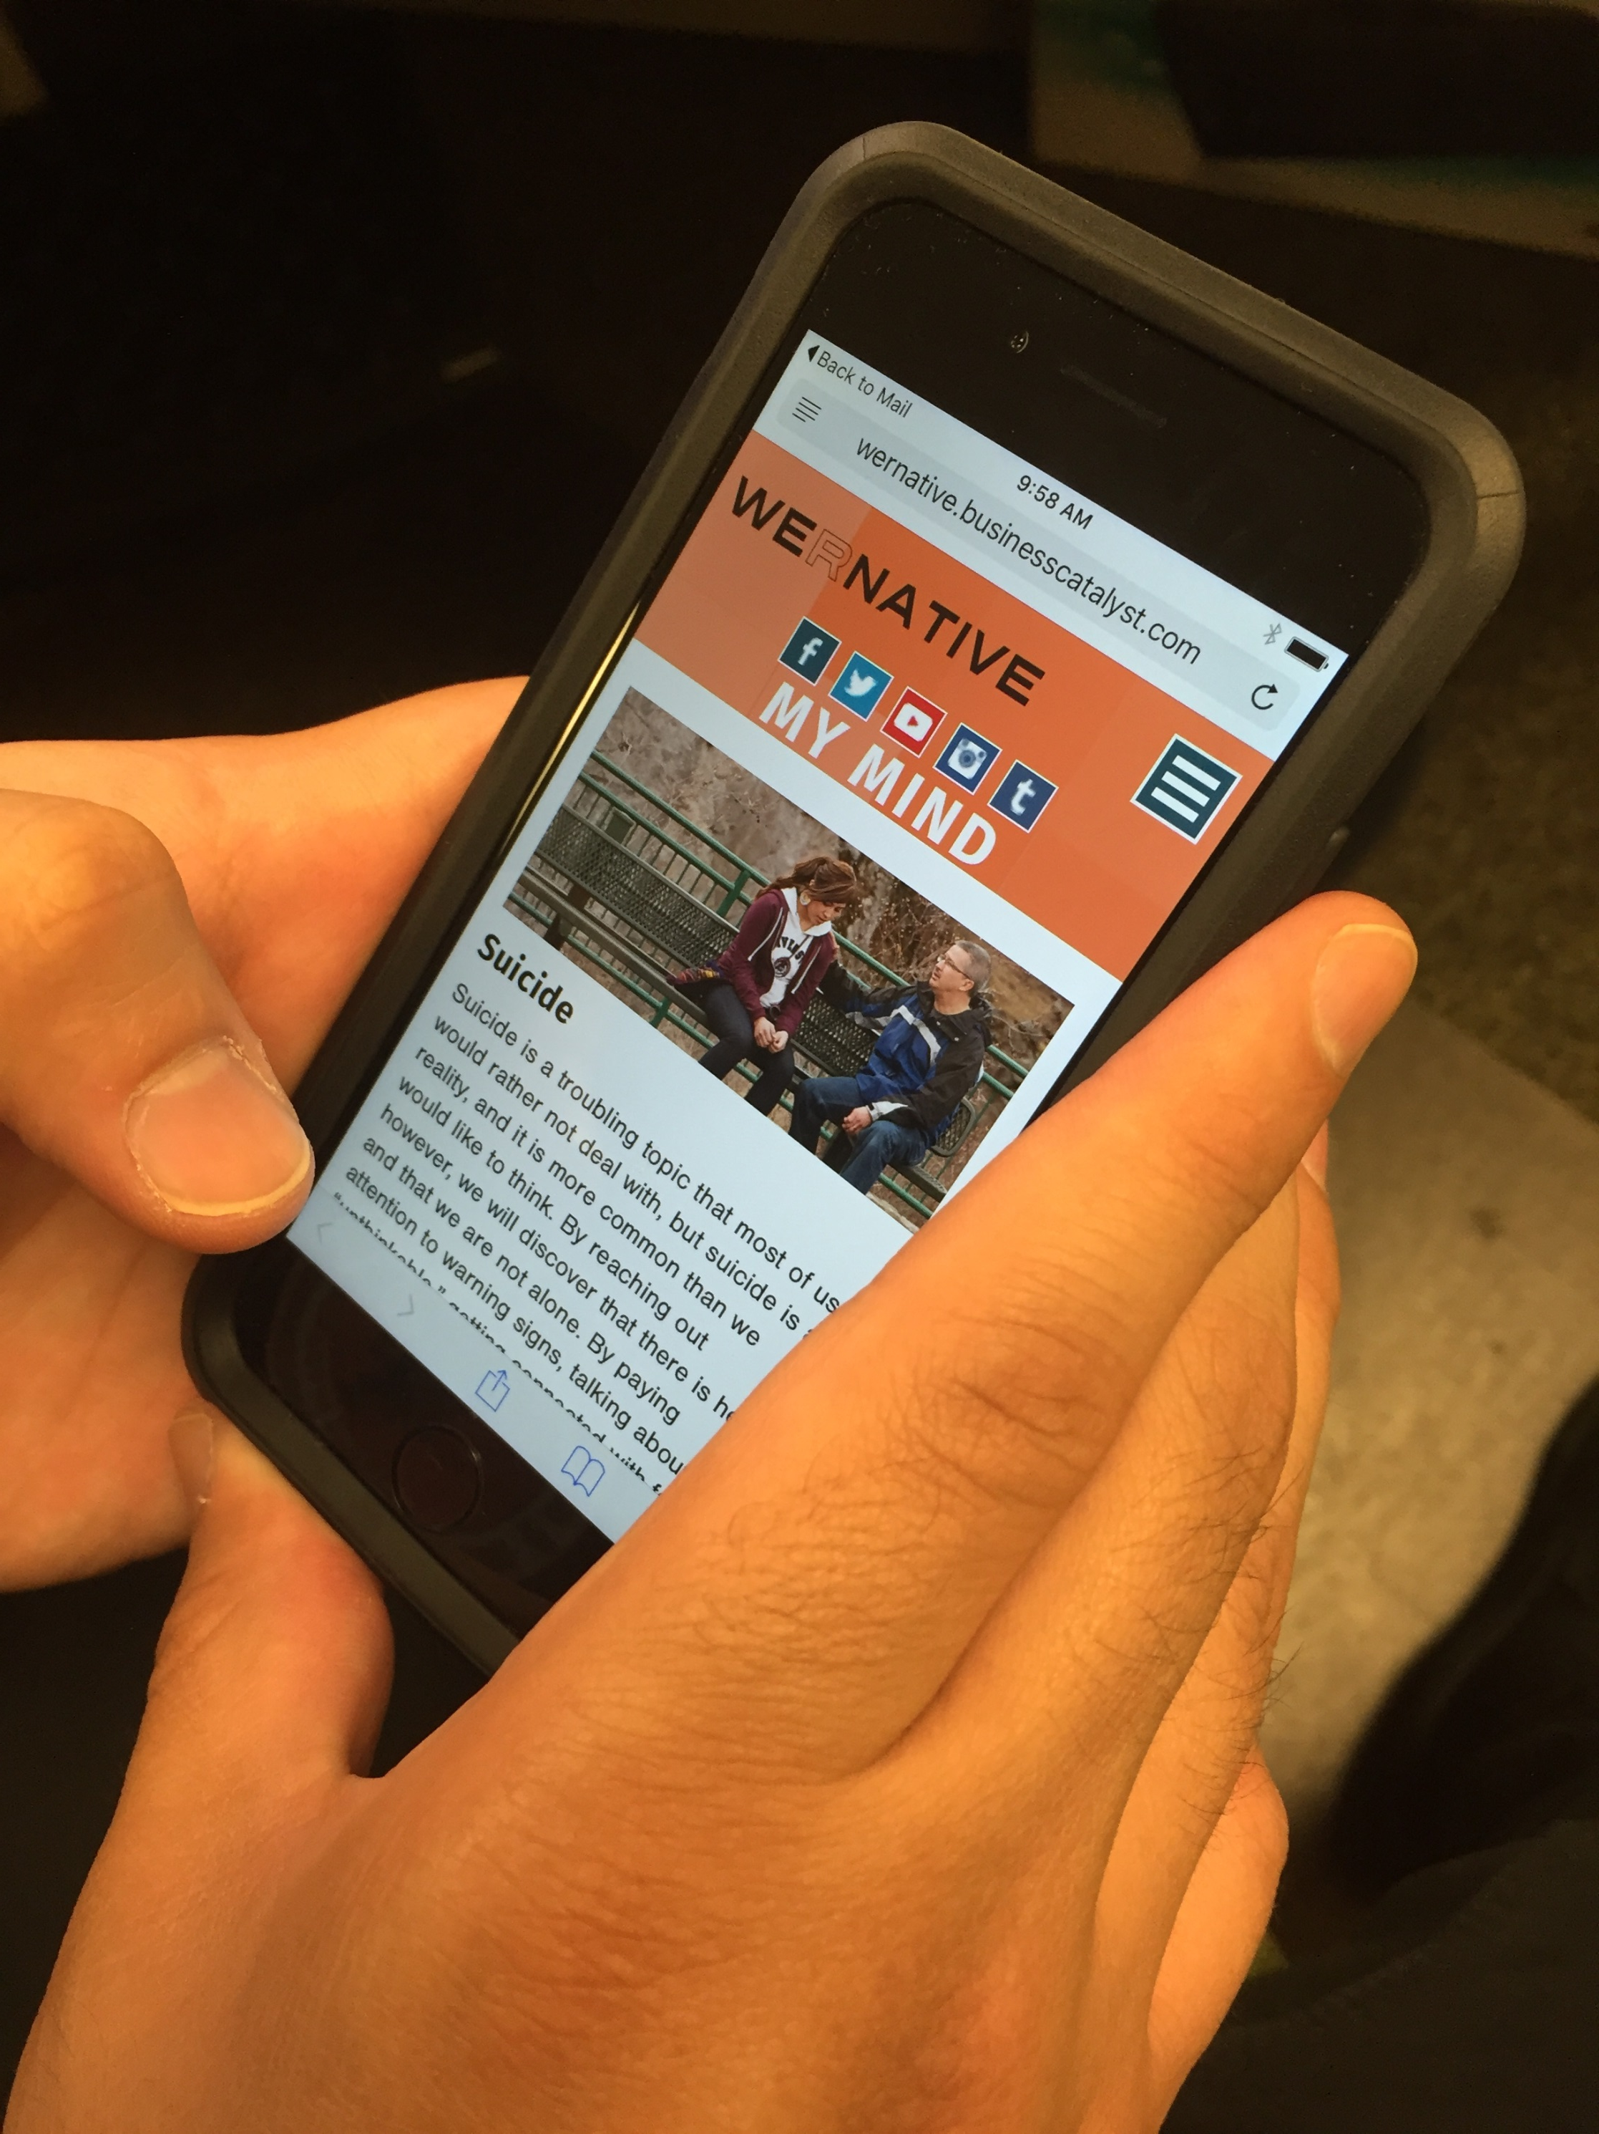
We also have
Notes:
The social media posts connected readers to the National Suicide Prevention Lifeline, and to other suicide prevention resource available on our website.

Slide 22
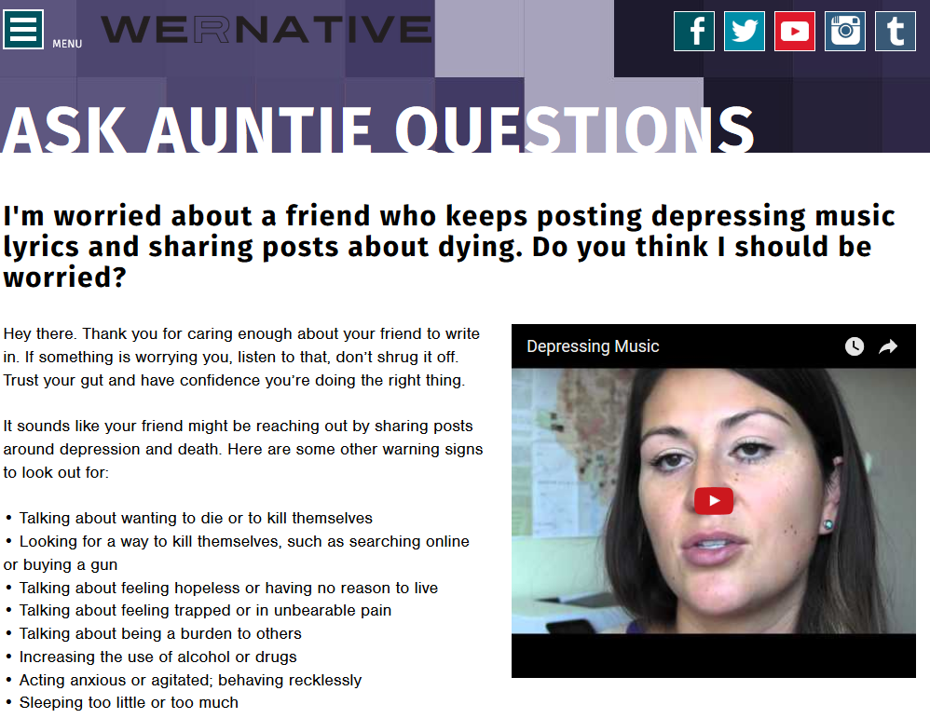
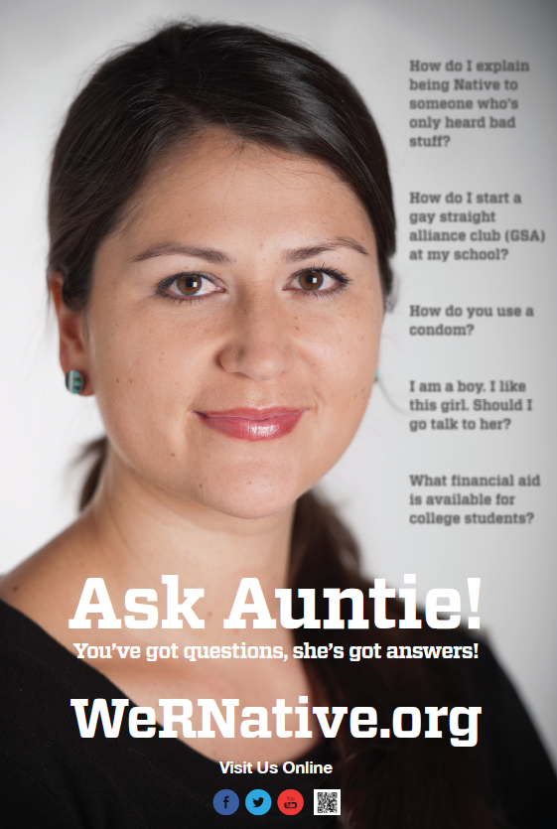
Concerning Social Media Posts
Notes:
We also used our anonymous “Ask Auntie” Q&A service to highlight suicide-related questions that’ve been submitted to the site.
It’s one of our most active sections of the website - Taking away the embarrassment youth might feel asking parents, friends, or healthcare providers.

Slide 23
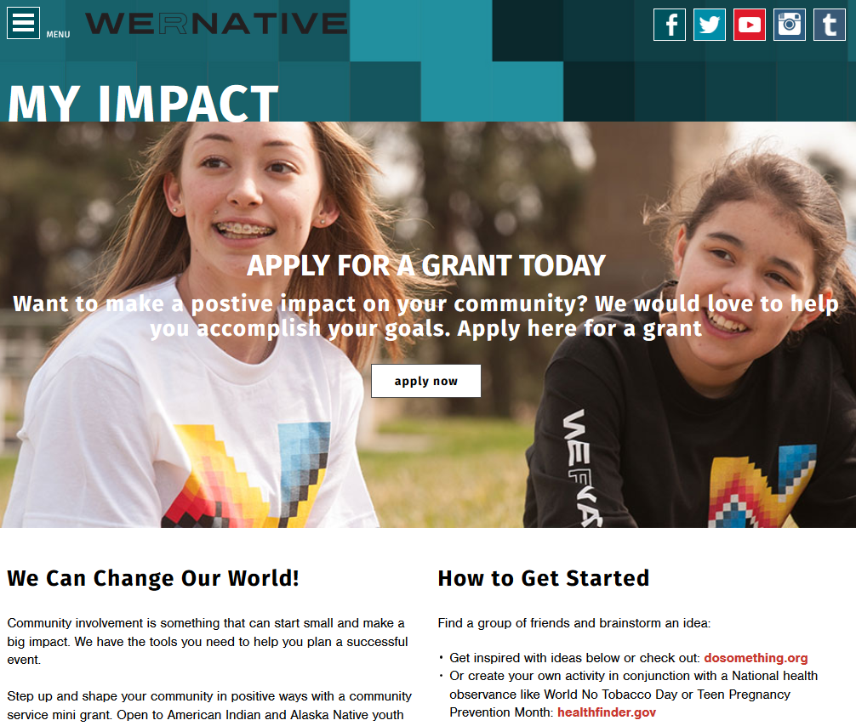
Notes:
Strategies to Boost User Engagement :
Engaging content – compelling images and stories
Amplify positive stories happening in Indian Country – youth doing good things.
Contests – We’ve learned though trial and error… Is it Actionable? Is your audience really going to do what you’re asking them to do? How many steps will it take?
Things that work for us (celebrities, humor, specific facts to our target audience)

Slide 24
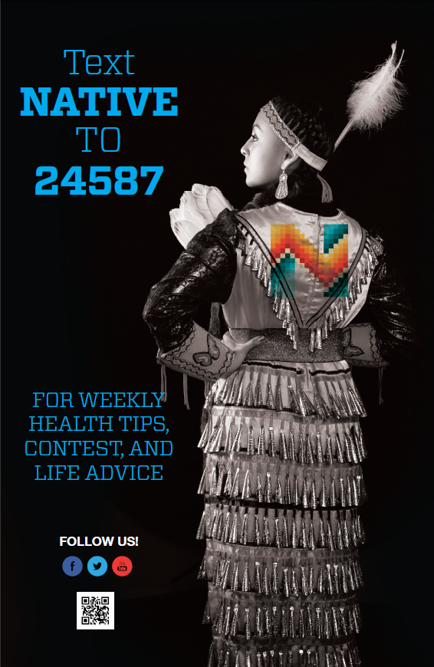
Notes:
To bring users back to the “meat and potatoes” on the website, we use monthly contests and Facebook, Instagram, and Text Message prompts.
To enroll, you just text the word NATIVE to 24587. Right now we have nearly 4,000 folks signed up for the service.

Slide 25
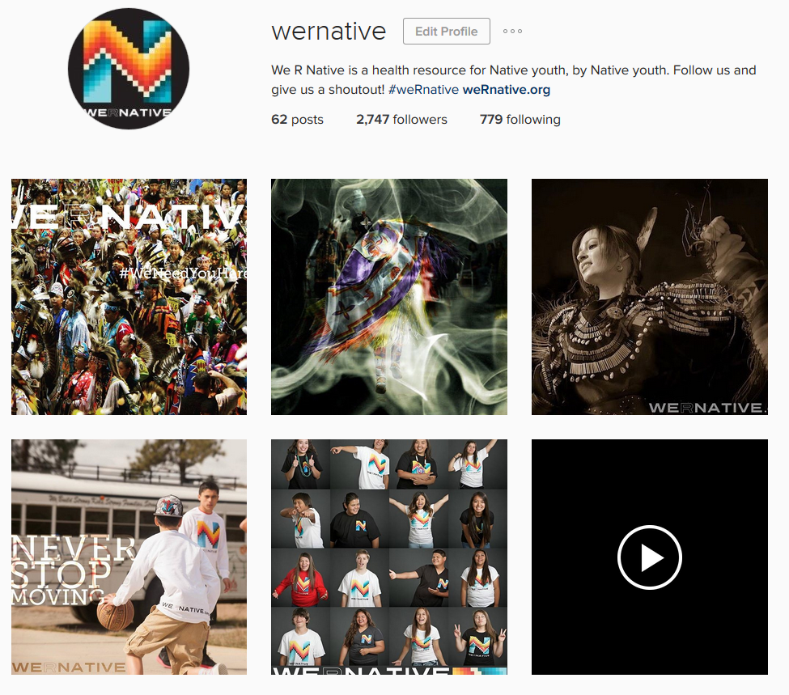
Notes:
Instagram

Slide 26
Northwest Portland Area Indian Health Board
Stephanie Craig Rushing, PhD, MPH
Director – Project Red Talon & THRIVE
scraig@npaihb.org
Colbie Caughlan, MPH
THRIVE Project Manager
ccaughlan@npaihb.org
Jessica Leston, MPH
STD/HIV Clinical Services Manager
jleston@npaihb.org
Amanda Gaston, MAT
Native It’s Your Game Project Manager
agaston@npaihb.org
David Stephens, RN
Multimedia Project Specialist
dstephens@npaihb.org
Tommy Ghost Dog
PRT Assistant
tghostdog@npaihb.org
Celena McCray
THRIVE Assistant
cmccray@npaihb.org
Indian Leadership for Indian Health
Notes:
If you’d like to contact the folks who manage THRIVE/PRT/We R Native…

